Slide 1

Noida Institute of Engineering and Technology, Greater Noida
Subject: Mathematics-III
Subject Code: AAS0301A
Unit: II
Complex Variable-Integration
Mr. Raman Chauhan
Department of
Mathematics
B Tech 3rd Sem

Slide 2
Sequence of contents
1 | Name of Subject with code, Course and Subject Teacher
2 | Brief Introduction of Faculty member with Photograph
3 | Evaluation Scheme
4 | Subject Syllabus
5 | Branch wise Applications
6 | Course Objective (Point wise)
7 | Course Outcomes (COs)
8 | Program Outcomes only heading (POs)
9 | COs and POs Mapping

Slide 3
Sequence of contents
10 | Program Specific Outcomes (PSOs)
11 | COs and PSOs Mapping
12 | Program Educational Objectives (PEOs)
13 | Result Analysis (Department Result, Subject Result and Individual Faculty Result)
14 | End Semester Question Paper Templates (Offline Pattern/Online Pattern)
15 | Prequisite/ Recap
16 | Brief Introduction about the Subject with videos
17 | Unit Content
18 | Unit Objective
19 | Topic Objective/Topic Outcome

Slide 4
Sequence of contents
20 | Lecture related to topic
21 | Daily Quiz
22 | Weekly Assignment
23 | Topic Links
24 | MCQ (End of Unit)
25 | Glossary Questions
26 | Old Question Papers (Sessional + University)
27 | Expected Questions
28 | Recap of Unit

Slide 5
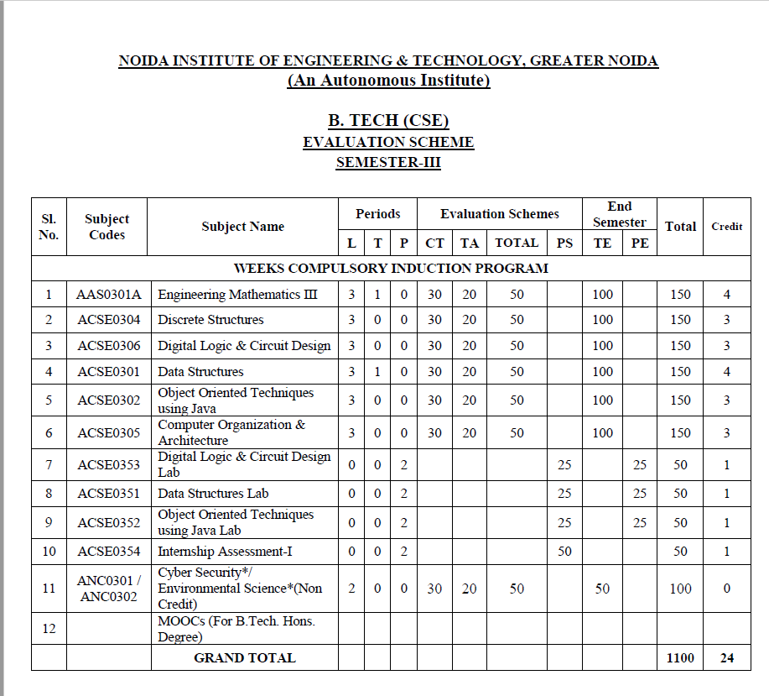
Evaluation Scheme

Slide 6

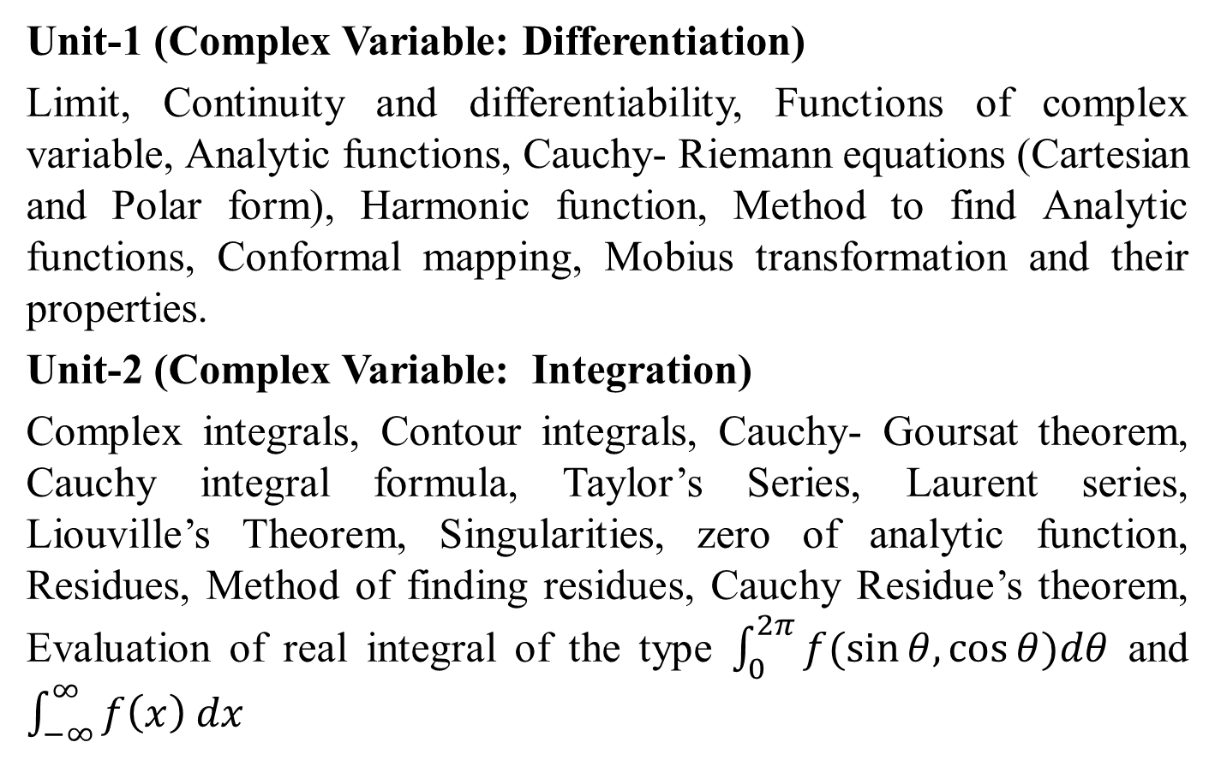
Syllabus
Unit-1 (Complex Variable: Differentiation)
Limit, Continuity and differentiability, Functions of complex variable, Analytic functions, Cauchy- Riemann equations (Cartesian and Polar form), Harmonic function, Method to find Analytic functions, Conformal mapping, Mobius transformation and their properties.
Unit-2 (Complex Variable: Integration)
Complex integrals, Contour integrals, Cauchy- Goursat theorem, Cauchy integral formula, Taylor’s Series, Laurent series, Liouville’s Theorem, Singularities, zero of analytic function, Residues, Method of finding residues, Cauchy Residue’s theorem, Evaluation of real integral of the type $\int_{0}^{2π}{f(\sin{θ,\cos{θ)dθ}}}$ and $\int_{−∞}^{∞}{f\left(x\right) dx}$

Slide 7
Syllabus
Unit-3 (Partial Differential Equation and its Applications)
Introduction of partial differential equations, Second order linear partial differential equations with constant coefficients. Classification of second order partial differential equations, Method of separation of variables for solving partial differential equations, Solution of one and two dimensional wave and heat conduction equations.

Slide 8
Syllabus
Unit-4 (Numerical Techniques)
Error analysis, Zeroes of transcendental and polynomial equations using Bisection method, Regula-falsi method and Newton-Raphson method, Interpolation: Finite differences, Newton’s forward and backward interpolation, Lagrange’s and Newton’s divided difference formula for unequal intervals. Solution of system of linear equations, Crout’s method, Gauss- Seidel method. Numerical integration: Trapezoidal rule, Simpson’s one third and three-eight rules, Solution of 1st order ordinary differential equations by fourth-order Runge- Kutta methods.
Unit-5 (Aptitude-III)
Time & Work, Pipe & Cistern, Time, Speed & Distance, Boat & Stream, Sitting Arrangement, Clock & Calendar.

Slide 9
Branch Wise Applications
Concept of Complex variable is used in speech recognition, image processing etc.
Function of complex variable helps in evaluation of area, which is required in many physical formulation.

Slide 10
Course Objective
The objective of this course is to familiarize the engineers with concept of function of complex variables, complex variables& their applications, Integral Transforms for various mathematical tasks and numerical aptitude. It aims to show case the students with standard concepts and tools from B. Tech to deal with advanced level of mathematics and applications that would be essential for their disciplines. The students will learn:
The idea of function of complex variables and analytic functions.
The idea of concepts of complex functions for evaluation of definite integrals
The concepts of concept of partial differential equation to solve partial differential and its applications.

Slide 11
Course Objective
The concept of finding roots by numerical method, interpolation and numerical methods for system of linear equations, definite integral and 1st order ordinary differential equations.
The concept of problems based on Time & Work, Pipe & Cistern, Time, Speed & Distance, Boat & Stream, Sitting Arrangement, Clock & Calendar.

Slide 12
Course Outcomes
CO1: Apply the working methods of complex functions for finding analytic functions.
CO2: Apply the concepts of complex functions for finding Taylor’s series, Laurent’s series and evaluation of definite integrals.
CO3: Apply the concept of partial differential equation to solve complex variables and problems concerned with partial differential equations

Slide 13
Course Outcomes
CO4: Apply the concept of numerical techniques to evaluate the zeroes of the Equation, concept of interpolation and numerical methods for various mathematical operations and tasks, such as integration, the solution of linear system of equations and the solution of differential equation.
CO5: Solve the problems of Time & Work, Pipe & Cistern, Time, Speed & Distance, Boat & Stream, Sitting Arrangement , Clock & Calendar.

Slide 14
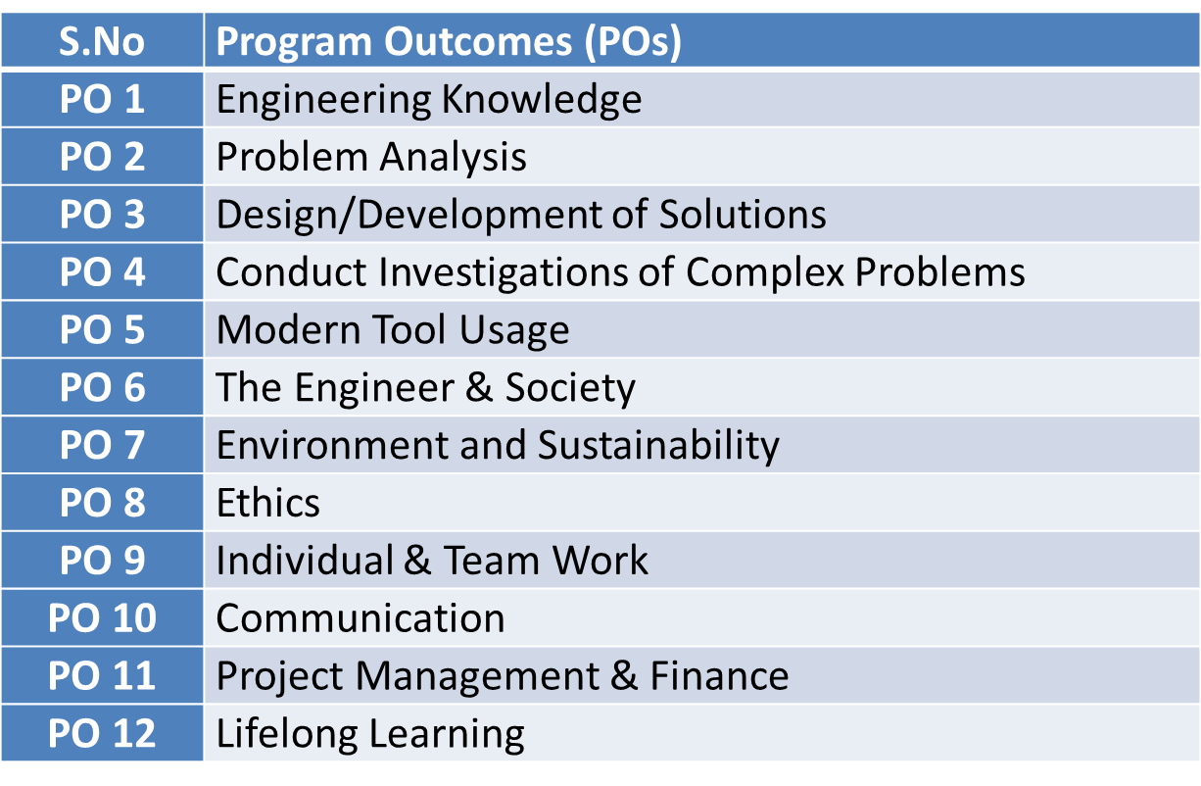
Program Outcomes

Slide 15
CO-PO Mapping(CO1)
Sr. No | Course Outcome | PO1 | PO2 | PO3 | PO4 | PO5 | PO6 | PO7 | PO8 | PO9 | PO10 | PO11 | PO12
1 | CO 1 | H | H | H | H | L | L | L | L | L | L | L | M
2 | CO 2 | H | H | H | H | L | L | L | L | L | L | M | M
3 | CO 3 | H | H | H | H | L | L | L | L | L | L | M | M
4 | CO 4 | H | H | H | H | L | L | L | L | L | L | L | M
5 | CO 5 | H | H | H | H | L | L | L | L | L | L | M | M
*L= Low *M= Medium *H= High

Slide 16
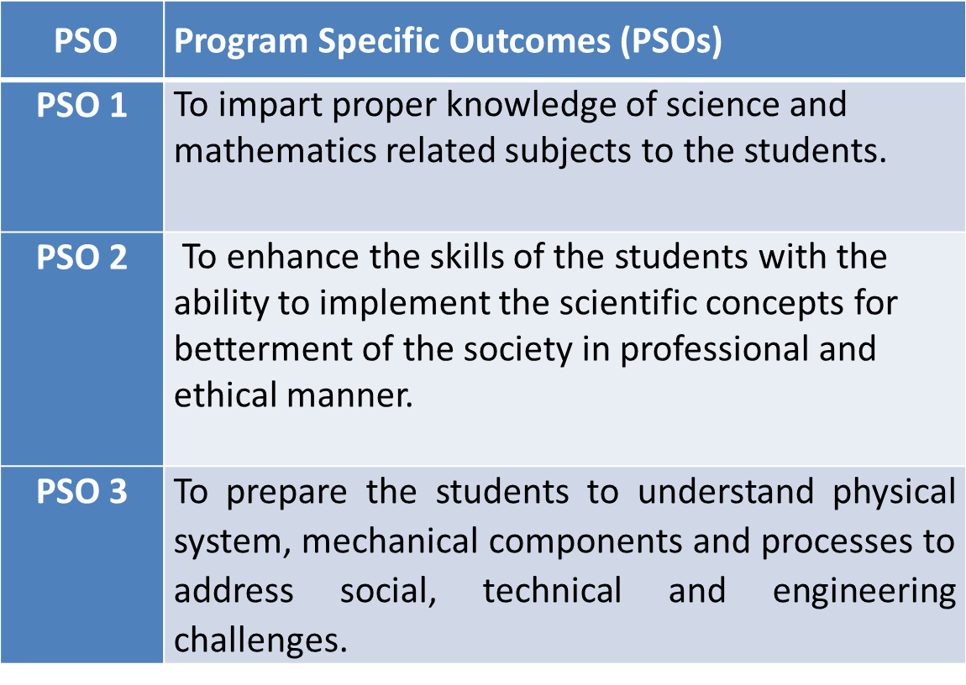
PSO

Slide 17
CO-PSO Mapping(CO1)
*L= Low *M= Medium *H= High
CO | PSO 1 | PSO 2 | PSO 3
CO.1 | H | L | M
CO.2 | L | M | L
CO.3 | M | M | M
CO.4 | H | M | M
CO.5 | H | M | M

Slide 18
Program Educational Objectives(PEOs)
PEO-1: To have an excellent scientific and engineering breadth so as to comprehend, analyze, design and provide sustainable solutions for real-life problems using state-of-the-art technologies.
PEO-2: To have a successful career in industries, to pursue higher studies or to support entrepreneurial endeavors and to face the global challenges.
PEO-3: To have an effective communication skills, professional attitude, ethical values and a desire to learn specific knowledge in emerging trends, technologies for research, innovation and product development and contribution to society.
PEO-4: To have life-long learning for up-skilling and re-skilling for successful professional career as engineer, scientist, entrepreneur and bureaucrat for betterment of society.

Slide 19
End Semester Question Paper Template
100 Marks Question Paper Template.docx

Slide 20
Prerequisite and Recap(CO1)
Knowledge of Integration
Knowledge of Complex function

Slide 21
Brief Introduction about the Subject with Videos
We will discuss properties of complex function (limits, continuity, differentiability, Analyticity and integration)
In 3rd module we will discuss application of partial differential equations
In 4th module we will discuss numerical methods for solving algebraic equations, system of linear equations, definite integral and 1st order ordinary differential equation.
In 5th module we will discuss aptitude part.
https://youtu.be/iUhwCfz18os
https://youtu.be/ly4S0oi3Yz8
https://youtu.be/f8XzF9_2ijs

Slide 22

Content
Complex integrals,
Contour integrals
Cauchy- Goursat theorem
Cauchy integral formula,
Taylor’s series and Laurent’s series,
Liouvilles’s theorem,
Singularities and Classification of Singularities,
Zeros of analytic functions,
Residues and methods of finding residues,
Cauchy Residue theorem,
Evaluation of real integrals of the type 𝑓(sin 𝜃, cos 𝜃)𝑑𝜃 .

Slide 23
Unit Objective(CO2)
The objective of this unit is to familiarize the engineers with concept of function of complex variables. It aims to show case the students with standard concepts and tools from B.Tech to deal with advanced level of mathematics and applications that would be essential for their disciplines.

Slide 24
Complex Variables(CO2)
Complex
Integration

Slide 25

Topic Objective(CO2)
We will evaluate the integration of complex function by:
Line Integral.
Cauchy’s Integral Theorem
Cauchy’s Integral Formula

Slide 26
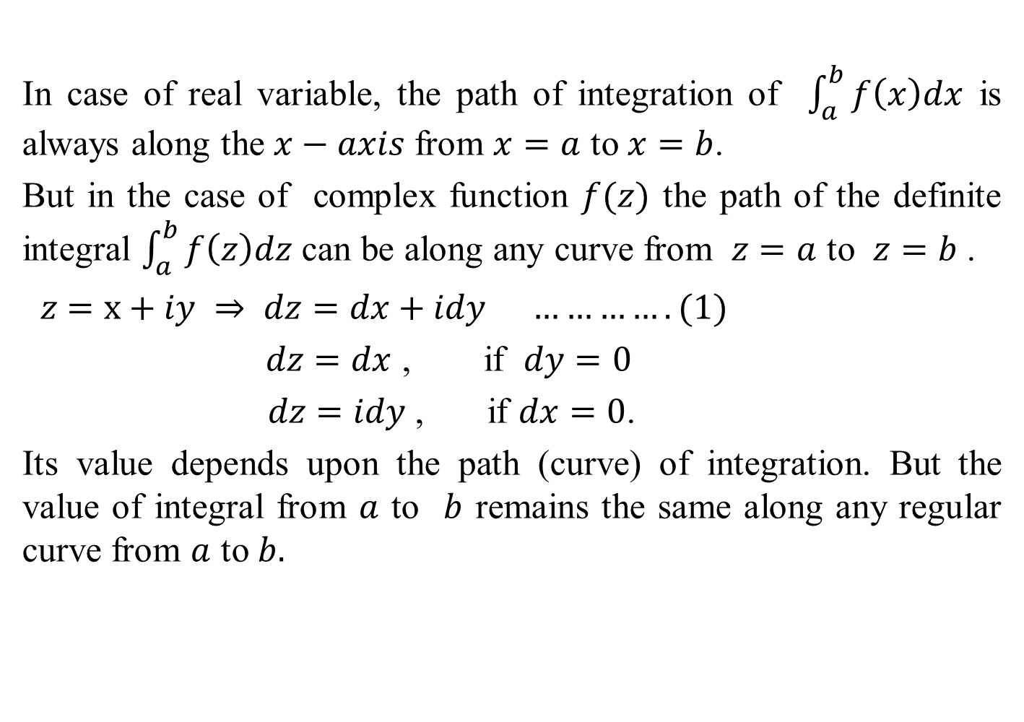
Line Integral in the Complex Plane(CO2)
In case of real variable, the path of integration of $\int_{a}^{b}{f\left(x\right)dx}$ is always along the $x−axis$ from $x=a$ to $x=b$.
But in the case of complex function $f(z)$ the path of the definite integral $\int_{a}^{b}{f\left(z\right)dz}$ can be along any curve from $z=a$ to $z=b$ .
$z$ $=x+iy ⇒ dz=dx+idy ………….(1)$
$dz=dx$ , if $dy=0$
$dz=idy$ , if $dx=0$.
Its value depends upon the path (curve) of integration. But the value of integral from $a$ to $b$ remains the same along any regular curve from $a$ to $b.$

Slide 27
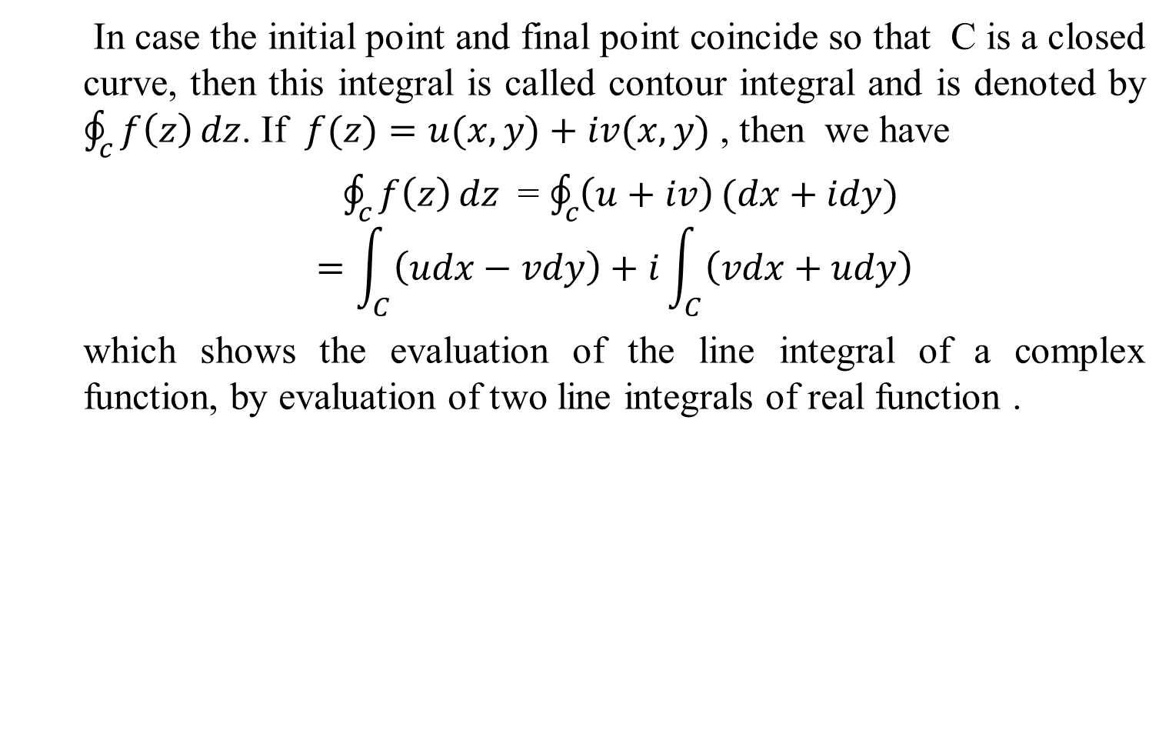
Line Integral in the Complex Plane(CO2)
In case the initial point and final point coincide so that C is a closed curve, then this integral is called contour integral and is denoted by $\oint_{c}{f\left(z\right)}dz$. If $f(z)=u(x, y)+iv(x, y)$ , then we have
$\oint_{c}{f\left(z\right)}dz$= $\oint_{c}{\left(u+iv\right)}(dx+idy)$
$$=\int_{C}^{ }{\left(udx−vdy\right)+i\int_{C}^{ }{\left(vdx+udy\right)}}$$
which shows the evaluation of the line integral of a complex function, by evaluation of two line integrals of real function .

Slide 28
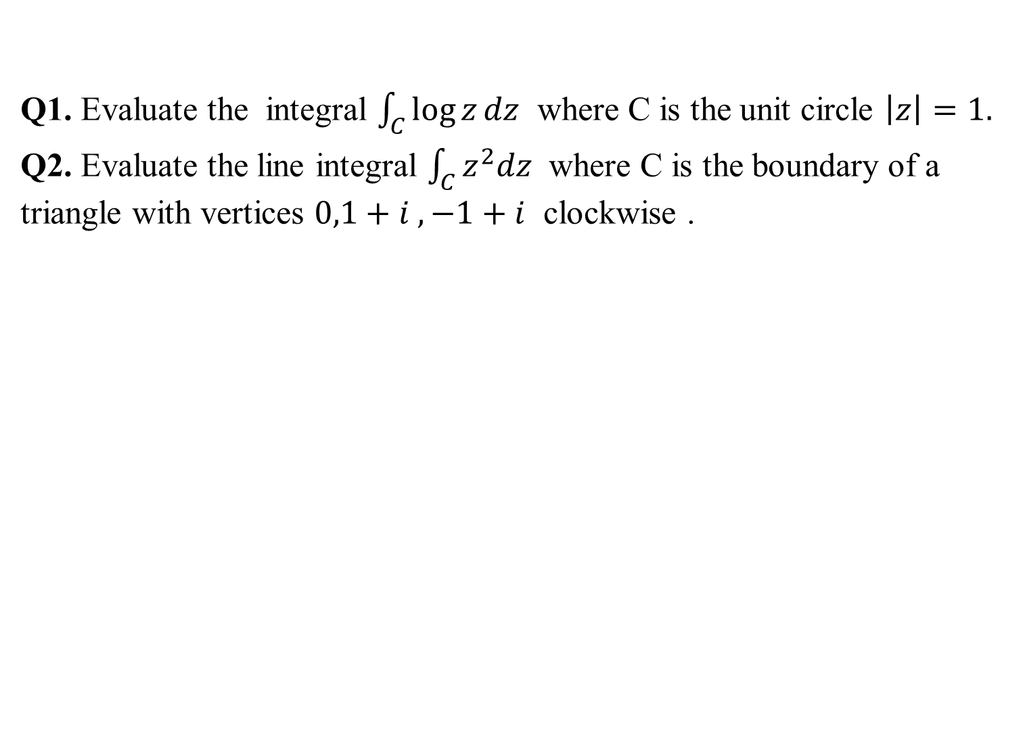
Daily Quiz(CO2)
Q1. Evaluate the integral $\int_{C}^{ }{\log{z}dz}$ where C is the unit circle $\left|z\right|=1.$
Q2. Evaluate the line integral $\int_{C}^{ }{z^{2}dz}$ where C is the boundary of a triangle with vertices $0,1+i ,−1+i$ clockwise .

Slide 29
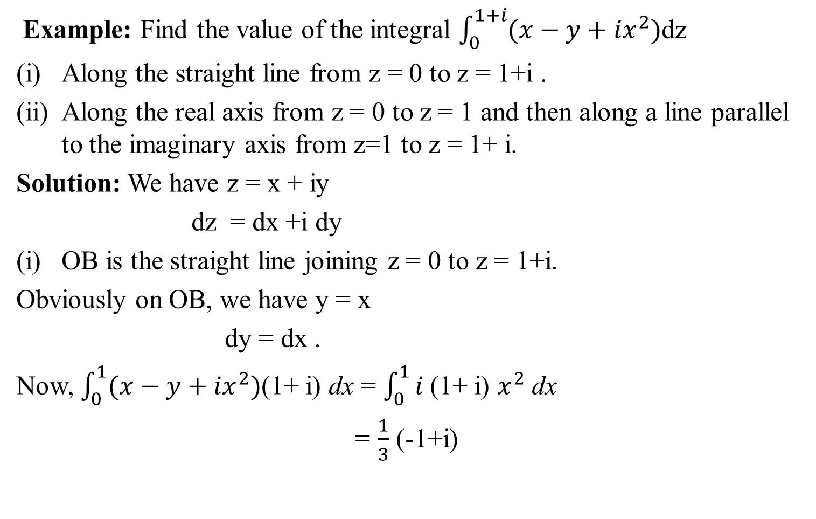
Line Integral in the Complex Plane(CO2)
Example: Find the value of the integral $\int_{0}^{1+i}{(x−y+{ix}^{2})}$dz
Along the straight line from z = 0 to z = 1+i .
Along the real axis from z = 0 to z = 1 and then along a line parallel to the imaginary axis from z=1 to z = 1+ i.
Solution: We have z = x + iy
dz = dx +i dy
OB is the straight line joining z = 0 to z = 1+i.
Obviously on OB, we have y = x
dy = dx .
Now, $\int_{0}^{1}{(x−y+{ix}^{2})}$(1+ i) dx = $\int_{0}^{1}{i }$(1+ i) $x^{2}$ dx
= $\frac{1}{3}$ (-1+i)
(1,1)
B
(1,0)
O
A

Slide 30
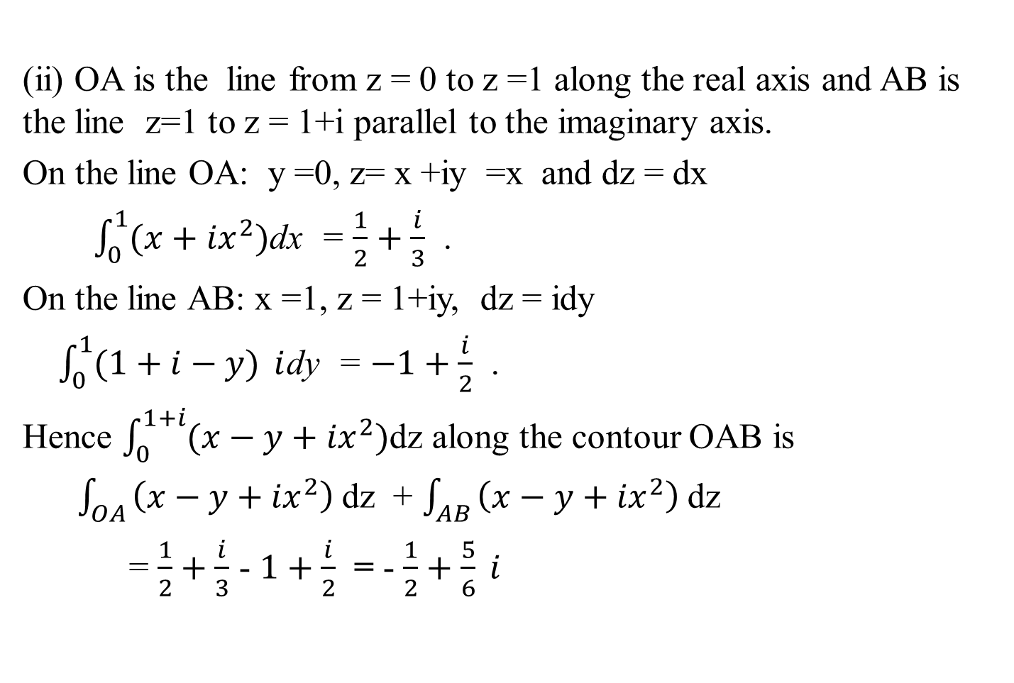
Line Integral in the Complex Plane(CO2)
(ii) OA is the line from z = 0 to z =1 along the real axis and AB is the line z=1 to z = 1+i parallel to the imaginary axis.
On the line OA: y =0, z= x +iy =x and dz = dx
$\int_{0}^{1}{(x+{ix}^{2})}$dx = $\frac{1}{2}+\frac{i}{3}$ .
On the line AB: x =1, z = 1+iy, dz = idy
$\int_{0}^{1}{(1+i−y)} i$dy = $−1+\frac{i}{2}$ .
Hence $\int_{0}^{1+i}{(x−y+{ix}^{2})}$dz along the contour OAB is
$\int_{OA }{\left(x−y+{ix}^{2}\right) }$dz + $\int_{AB }{\left(x−y+{ix}^{2}\right) }$dz
= $\frac{1}{2}+\frac{i}{3}$ - $1+\frac{i}{2}$ = - $\frac{1}{2}+\frac{5}{6} i$

Slide 31
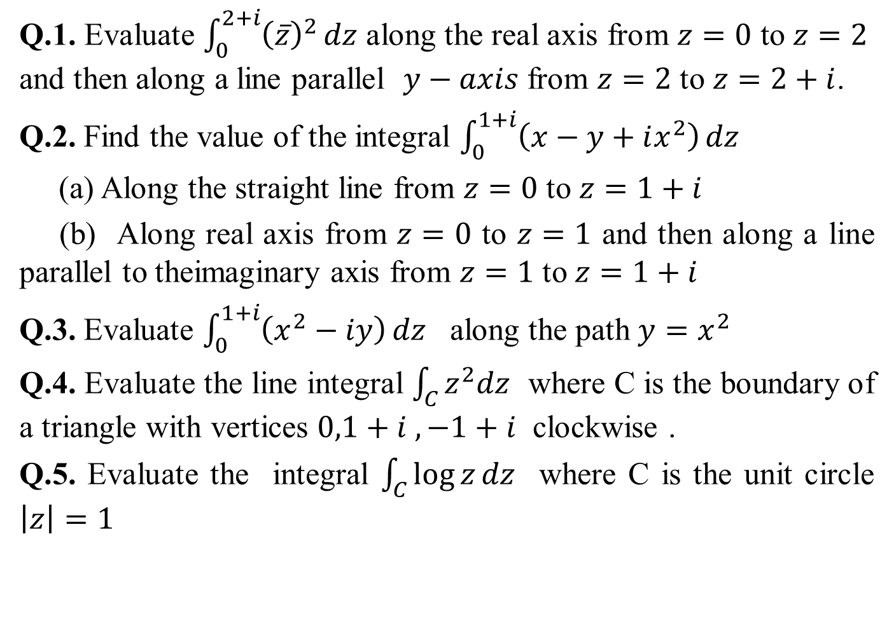
Weekly Assignment(CO2)
Q.1. Evaluate $\int_{0}^{2+i}{{\left(\overline{z}\right)}^{2}}dz$ along the real axis from $z=0$ to $z=2$ and then along a line parallel $y−axis$ from $z=2$ to $z=2+i$.
Q.2. Find the value of the integral $\int_{0}^{1+i}{\left(x−y+ix^{2}\right)}dz$
(a) Along the straight line from $z=0$ to $z=1+i$
(b) Along real axis from $z=0$ to $z=1$ and then along a line parallel to theimaginary axis from $z=1$ to $z=1+i$
Q.3. Evaluate $\int_{0}^{1+i}{\left(x^{2}−iy\right)}dz$ along the path $y=x^{2}$
Q.4. Evaluate the line integral $\int_{C}^{ }{z^{2}dz}$ where C is the boundary of a triangle with vertices $0,1+i ,−1+i$ clockwise .
Q.5. Evaluate the integral $\int_{C}^{ }{\log{z}dz}$ where C is the unit circle $\left|z\right|=1$

Slide 32
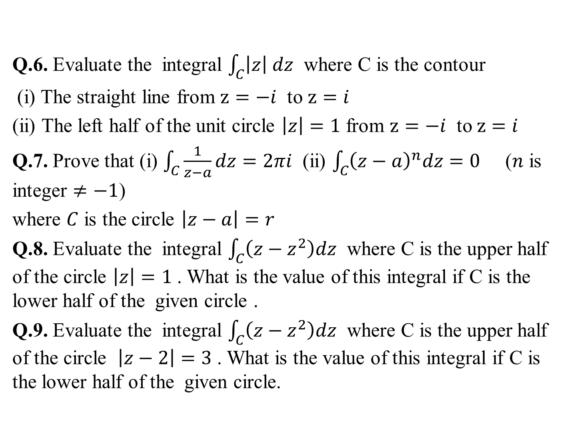
CONTINUED……
Weekly Assignment(CO2)
Q.6. Evaluate the integral $\int_{C}^{ }{\left|z\right| dz}$ where C is the contour
(i) The straight line from $z=−i$ to $z=i$
(ii) The left half of the unit circle $\left|z\right|=1$ from $z=−i$ to $z=i$
Q.7. Prove that (i) $\int_{C}^{ }{\frac{1}{z−a}dz=2πi}$ (ii) $\int_{C}^{ }{{\left(z−a\right)}^{n}dz=0}$ ($n$ is integer $≠−1$)
where $C$ is the circle $\left|z−a\right|=r$
Q.8. Evaluate the integral $\int_{C}^{ }{\left(z−z^{2}\right)dz}$ where C is the upper half of the circle $\left|z\right|=1$ . What is the value of this integral if C is the lower half of the given circle .
Q.9. Evaluate the integral $\int_{C}^{ }{\left(z−z^{2}\right)dz}$ where C is the upper half of the circle $\left|z−2\right|=3$ . What is the value of this integral if C is the lower half of the given circle.

Slide 33

CONTINUED……
Weekly Assignment(CO2)
Q.10. Evaluate the integral $\int_{C}^{ }{\frac{2z+3}{z}dz}$ where C is
(i) the upper half of the circle $\left|z\right|=2$ in clockwise direction .
(ii) the lower half of the circle $\left|z\right|=2$ in anti clockwise direction.

Slide 34

Cauchy’s Integral Theorem(CO2)
Statement :
If $f\left(z\right)$ is an analytic function and $f^{′}\left(z\right)$ is
continuous at all points inside and on a simple closed curve C , then
$\int_{c}^{ }{f\left(z\right)dz}=0$

Slide 35

Daily Quiz(CO2)
Q1. Verify Cauchy’s theorem for the function $f\left(z\right)=e^{iz}$ along the boundary of the triangle with vertices at the points 1+i ,-1+i and -1-i .

Slide 36
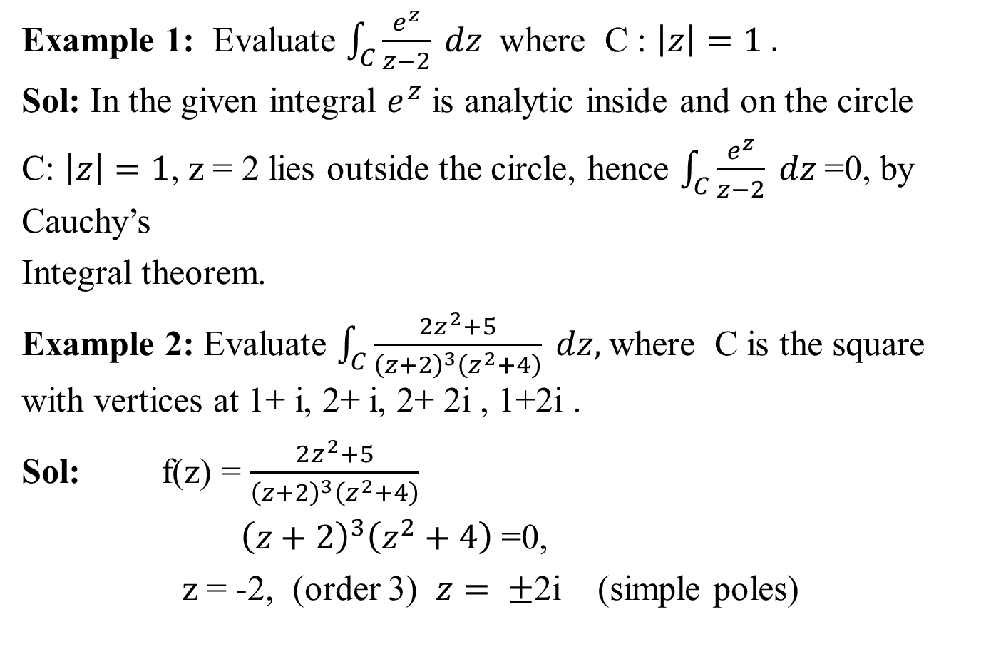
Cauchy’s Integral Theorem(CO2)
Example 1: Evaluate $\int_{C}{\frac{e^{z}}{z−2} dz }$ where C : $\left|z\right|=1 .$
Sol: In the given integral $e^{z}$ is analytic inside and on the circle
C: $\left|z\right|=1$, z = 2 lies outside the circle, hence $\int_{C}{\frac{e^{z}}{z−2} dz }$=0, by Cauchy’s
Integral theorem.
Example 2: Evaluate $\int_{C}{\frac{2z^{2}+5}{{\left(z+2\right)}^{3}\left(z^{2}+4\right)} dz, }$where C is the square with vertices at 1+ i, 2+ i, 2+ 2i , 1+2i .
Sol: f(z) = $\frac{2z^{2}+5}{{\left(z+2\right)}^{3}\left(z^{2}+4\right)}$
${ \left(z+2\right)}^{3}\left(z^{2}+4\right)$ =0,
z = -2, (order 3) $z= ±$2i (simple poles)

Slide 37

Cauchy’s Integral Theorem(CO2)
Since the singularities does not lie inside the contour C hence by Cauchy’s integral theorem $\int_{C}{\frac{2z^{2}+5}{{\left(z+2\right)}^{3}\left(z^{2}+4\right)} dz }$ =0

Slide 38
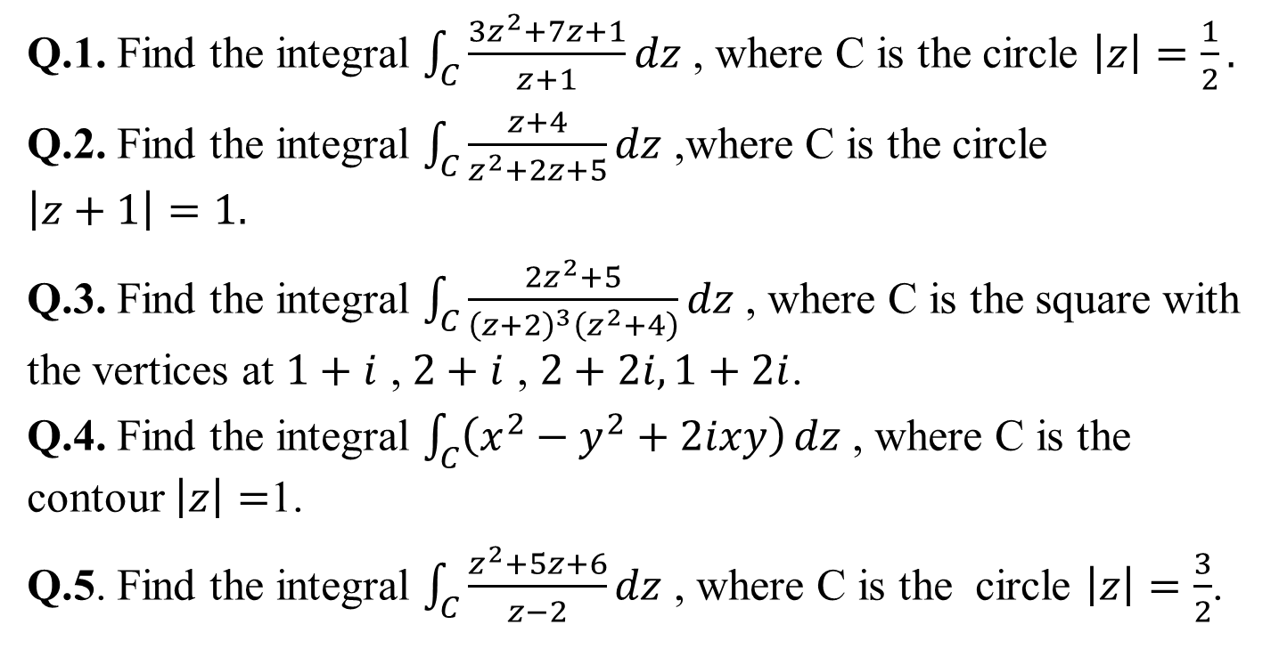
CONTINUED……
Weekly Assignment(CO2)
Q.1. Find the integral $\int_{C}^{ }{\frac{3z^{2}+7z+1}{z+1}}dz$ , where C is the circle $\left|z\right|=\frac{1}{2}.$
Q.2. Find the integral $\int_{C}^{ }{\frac{z+4}{z^{2}+2z+5}}dz$ ,where C is the circle
$$\left|z+1\right|=1.$$
Q.3. Find the integral $\int_{C}^{ }{\frac{2z^{2}+5}{{\left(z+2\right)}^{3}\left(z^{2}+4\right)}}dz$ , where C is the square with the vertices at $1+i$ , $2+i$ , $2+2i,1+2i$.
Q.4. Find the integral $\int_{C}^{ }{\left(x^{2}−y^{2}+2ixy\right)}dz$ , where C is the contour $\left|z\right|=$1.
Q.5. Find the integral $\int_{C}^{ }{\frac{z^{2}+5z+6}{z−2}}dz$ , where C is the circle $\left|z\right|=\frac{3}{2}$.

Slide 39
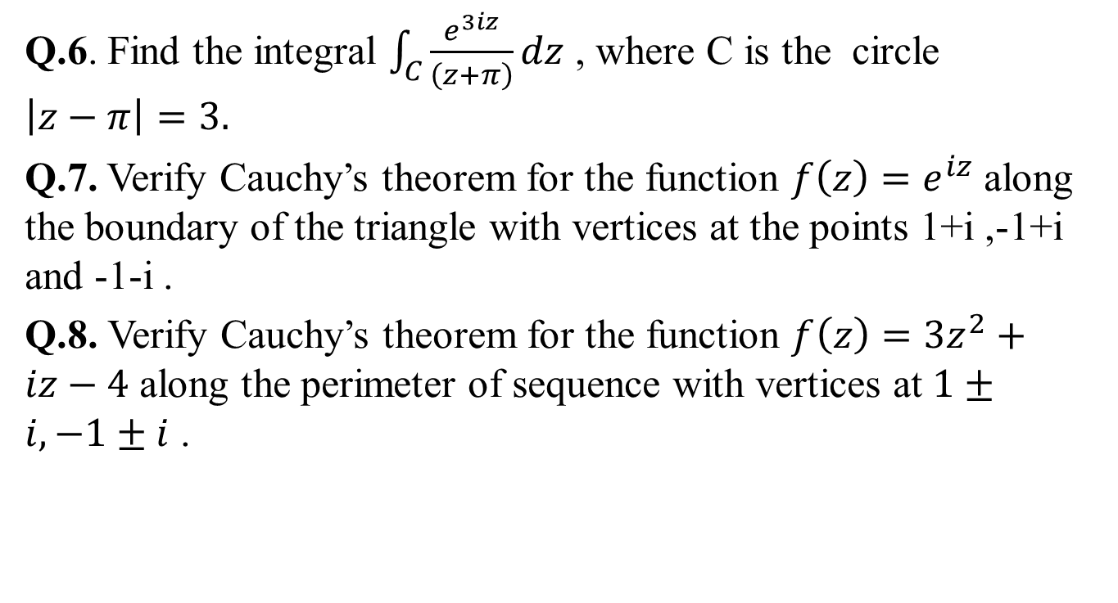
CONTINUED……
Weekly Assignment(CO2)
Q.6. Find the integral $\int_{C}^{ }{\frac{e^{3iz}}{\left(z+π\right)}}dz$ , where C is the circle $\left|z−π\right|=3.$
Q.7. Verify Cauchy’s theorem for the function $f\left(z\right)=e^{iz}$ along the boundary of the triangle with vertices at the points 1+i ,-1+i and -1-i .
Q.8. Verify Cauchy’s theorem for the function $f\left(z\right)=3z^{2}+iz−4$ along the perimeter of sequence with vertices at $1±i,−1±i$ .

Slide 40
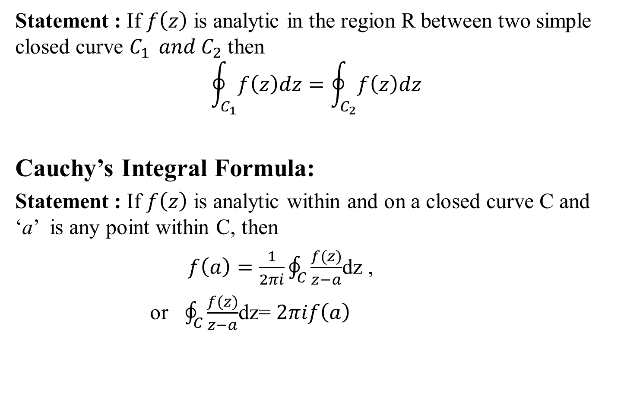
Extension of Cauchy’s integral theorem(CO2)
Statement : If $f\left(z\right)$ is analytic in the region R between two simple closed curve $C_{1 } and C_{2}$ then
$$\oint_{C_{1}}^{ }{f\left(z\right)dz}=\oint_{C_{2}}^{ }{f\left(z\right)dz}$$
Cauchy’s Integral Formula:
Statement : If $f\left(z\right)$ is analytic within and on a closed curve C and ‘a’ is any point within C, then
$f\left(a\right)=\frac{1}{2πi}\oint_{C}^{ }{\frac{f(z)}{z−a}}$dz ,
or $\oint_{C}^{ }{\frac{f(z)}{z−a}}$dz= $2πif\left(a\right)$

Slide 41

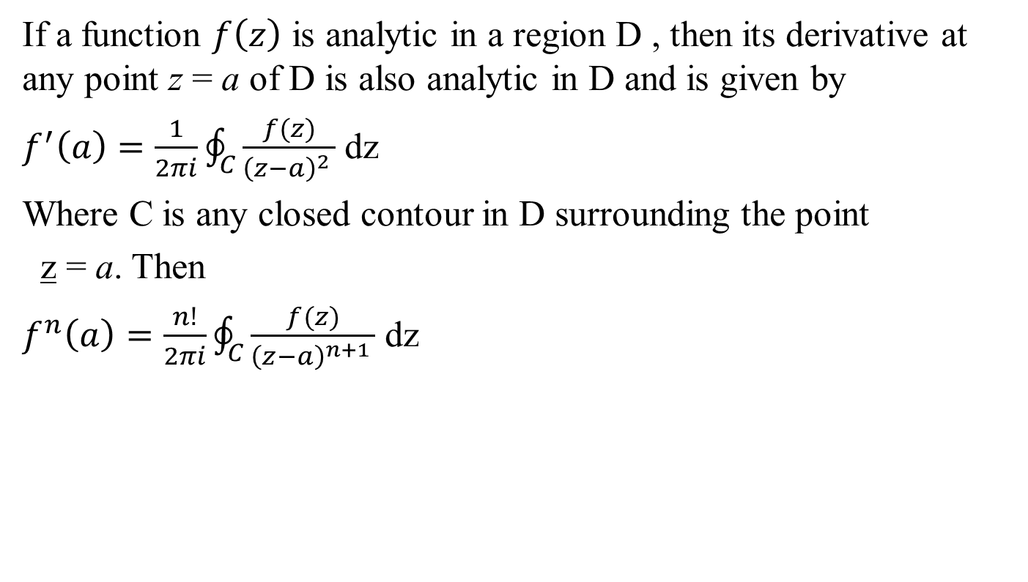
Cauchy’s integral formula for derivatives (CO2)
If a function $f\left(z\right)$ is analytic in a region D , then its derivative at any point z = a of D is also analytic in D and is given by
$f^{′}\left(a\right)=\frac{1}{2πi}\oint_{C}^{ }{\frac{f(z)}{{\left(z−a\right)}^{2 }}}$ dz
Where C is any closed contour in D surrounding the point
z = a. Then
$f^{n}\left(a\right)=\frac{n!}{2πi}\oint_{C}^{ }{\frac{f(z)}{{\left(z−a\right)}^{n+1 }}}$ dz

Slide 42

Daily Quiz(CO2)
Use Cauchy integral formula to evaluate
$$\oint_{C}^{ }{\frac{4−3z}{z\left(z−1\right)\left(z−2\right)}} dz$$
where C is the circle $\left|z\right|=3/2$ .

Slide 43
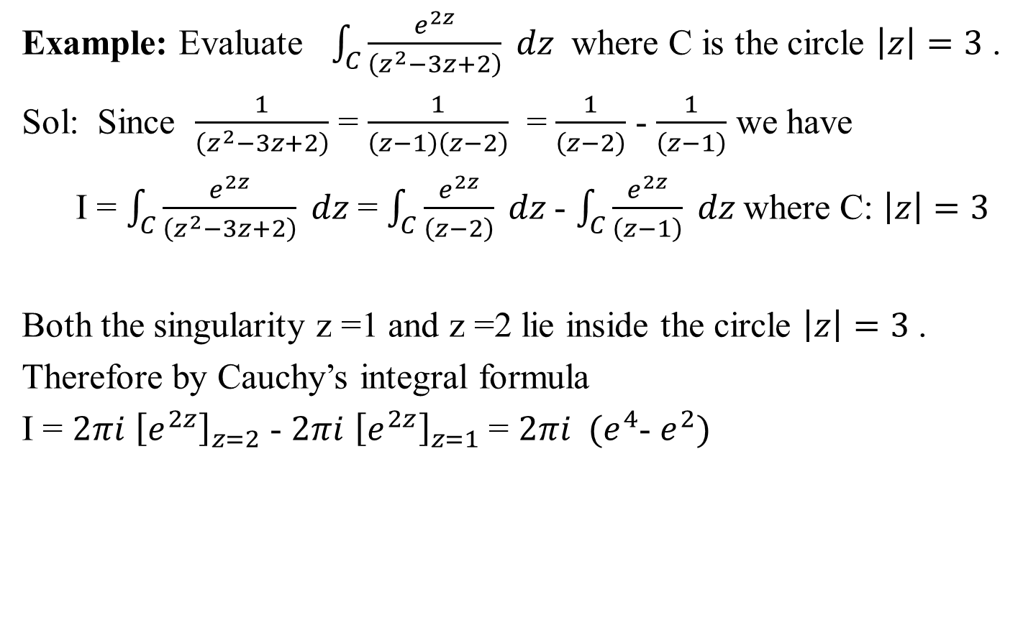
Cauchy’s Integral Theorem(CO2)
Example: Evaluate $\int_{C}{\frac{e^{2z}}{\left(z^{2}−3z+2\right)} dz }$ where C is the circle $\left|z\right|=3$ .
Sol: Since $\frac{1}{\left(z^{2}−3z+2\right)}$ = $\frac{1}{\left(z−1\right)\left(z−2\right)}$ = $\frac{1}{\left(z−2\right)}$ - $\frac{1}{\left(z−1\right)}$ we have
I = $\int_{C}{\frac{e^{2z}}{\left(z^{2}−3z+2\right)} dz }$= $\int_{C}{\frac{e^{2z}}{\left(z−2\right)} dz }$- $\int_{C}{\frac{e^{2z}}{\left(z−1\right)} dz }$where C: $\left|z\right|=3$
Both the singularity z =1 and z =2 lie inside the circle $\left|z\right|=3$ .
Therefore by Cauchy’s integral formula
I = $2πi$ ${\left[e^{2z}\right]}_{z=2}$ - $2πi$ ${\left[e^{2z}\right]}_{z=1}$ = $2πi { (e}^{4}$- $e^{2})$

Slide 44
Recap(CO2)
We have discussed.
Line Integral.
Cauchy Integral Theorem
Cauchy’s Integral Formula

Slide 45
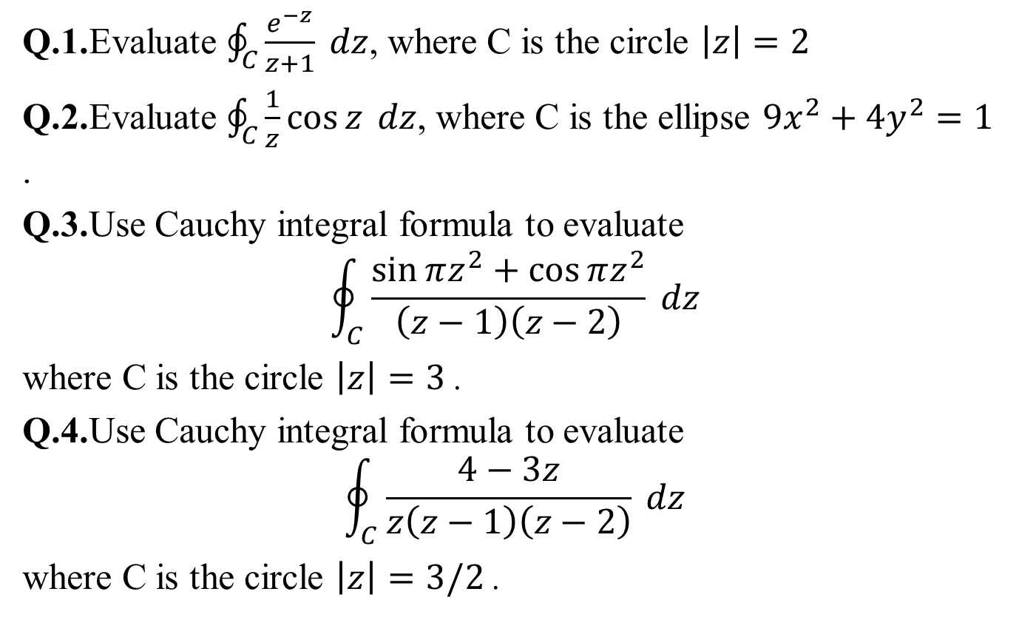
Weekly Assignment(CO2)
Q.1.Evaluate $\oint_{C}^{ }{\frac{e^{−z}}{z+1}} dz$, where C is the circle $\left|z\right|=2$
Q.2.Evaluate $\oint_{C}^{ }{\frac{1}{z}\cos{z}} dz$, where C is the ellipse $9x^{2}+4y^{2}=1$ .
Q.3.Use Cauchy integral formula to evaluate
$$\oint_{C}^{ }{\frac{\sin{πz^{2}+\cos{πz^{2}}}}{\left(z−1\right)\left(z−2\right)}} dz$$
where C is the circle $\left|z\right|=3$ .
Q.4.Use Cauchy integral formula to evaluate
$$\oint_{C}^{ }{\frac{4−3z}{z\left(z−1\right)\left(z−2\right)}} dz$$
where C is the circle $\left|z\right|=3/2$ .

Slide 46

Weekly Assignment(CO2)
Q.5.Use Cauchy integral formula to evaluate
$\oint_{C}^{ }{\frac{z}{z^{2}−3z+2}} dz$, Where C is the circle $\left|z−2\right|=1/2$ .

Slide 47
Topic Objective(CO2)
We will discuss.
Taylor’s series
Laurent’s Expansion

Slide 48

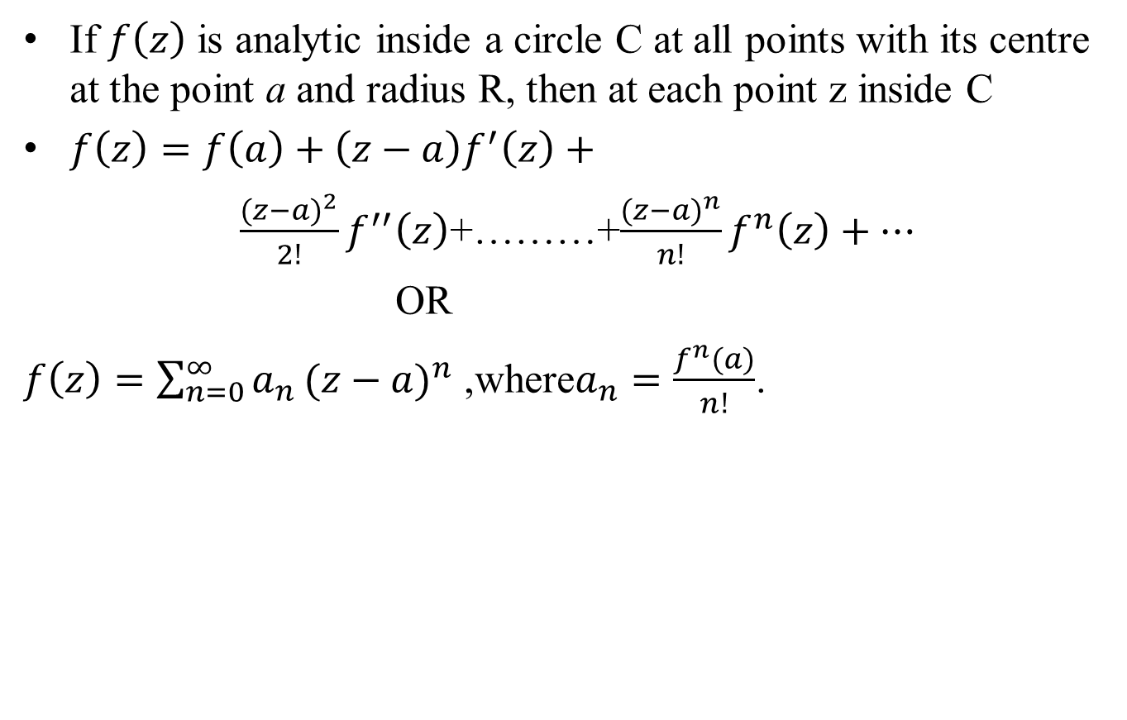
Taylor’s Series (CO2)
If $f\left(z\right)$ is analytic inside a circle C at all points with its centre at the point a and radius R, then at each point z inside C
$f\left(z\right)=f\left(a\right)+\left(z−a\right)f^{′}\left(z\right)+$
$\frac{{(z−a)}^{2}}{2!}f^{′′}\left(z\right)$+………+$\frac{{(z−a)}^{n}}{n!}f^{n}\left(z\right)+…$
OR
$f\left(z\right)=\sum_{n=0}^{∞}{a_{n}}{(z−a)}^{n}$ ,where$a_{n}=\frac{f^{n}(a)}{n!}$.

Slide 49

Laurent’s Series
Maclaurin’ s Series(CO2)
If $f\left(z\right)$ is analytic on $C_{1 } and C_{2}$, and the annular region R bounded by the two concentric circle $C_{1 } and C_{2}$of radius $r_{1}and r_{2} (r_{2}<r_{1})$ and with center at a then for all z in R
$f\left(z\right)=a_{0}+a_{1}\left(z−a\right)+a_{2}{(z−a)}^{2}+…+\frac{b_{1}}{\left(z−a\right)}+ \frac{b_{1}}{{\left(z−a\right)}^{2}}+…$
$=\sum_{n=0}^{∞}{a_{n}}{(z−a)}^{n}+\sum_{n=1}^{∞}{b_{n}}{(z−a)}^{−n}$

Slide 50

Laurent’s Series l
Daily Quiz(CO2)
Q1. Expand $f\left(z\right)=\frac{Z}{(Z+1)(Z+2)}$ about z = -2.

Slide 51
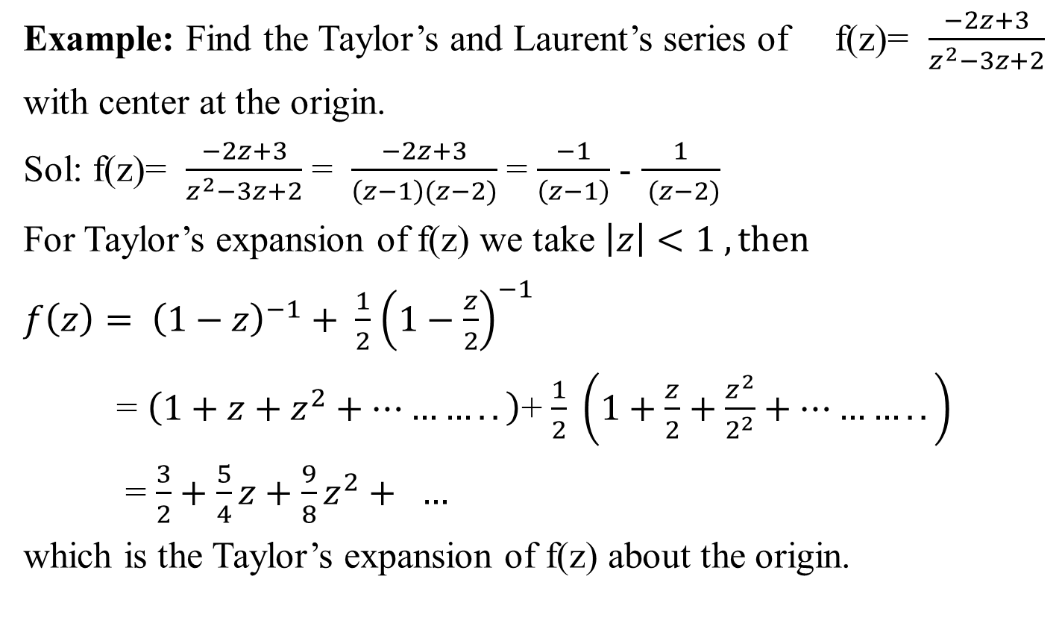
Taylor’s Series(CO2)
Example: Find the Taylor’s and Laurent’s series of f(z)= $\frac{−2z+3}{z^{2}−3z+2}$
with center at the origin.
Sol: f(z)= $\frac{−2z+3}{z^{2}−3z+2}$ = $\frac{−2z+3}{\left(z−1\right)(z−2)}$ = $\frac{−1}{\left(z−1\right)}$ - $\frac{1}{ (z−2)}$
For Taylor’s expansion of f(z) we take $\left|z\right|<1 , then$
$f\left(z\right)= {\left(1−z\right)}^{−1}+ \frac{1}{2}$ ${\left(1−\frac{z}{2}\right)}^{−1}$
= $\left(1+z+z^{2}+………..\right)$+ $\frac{1}{2} \left(1+\frac{z}{2}+\frac{z^{2}}{2^{2}}+………..\right)$
= $\frac{3}{2}+\frac{5}{4}z+\frac{9}{8}z^{2}+ …$
which is the Taylor’s expansion of f(z) about the origin.

Slide 52
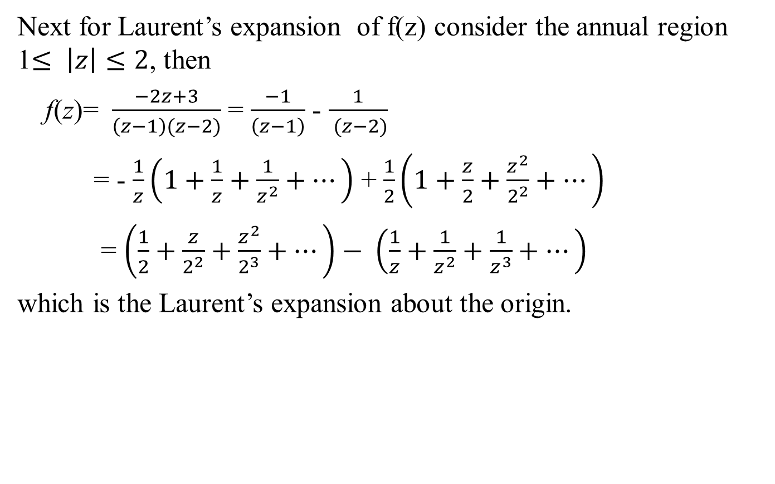
Taylor’s Series(CO2)
Next for Laurent’s expansion of f(z) consider the annual region 1$≤ \left|z\right|≤2$, then
f(z)= $\frac{−2z+3}{\left(z−1\right)(z−2)}$ = $\frac{−1}{\left(z−1\right)}$ - $\frac{1}{ (z−2)}$
= - $\frac{1}{z}\left(1+\frac{1}{z}+\frac{1}{z^{2}}+…\right)$ + $\frac{1}{2}\left(1+\frac{z}{2}+\frac{z^{2}}{2^{2}}+…\right)$
= $\left(\frac{1}{2}+\frac{z}{2^{2}}+\frac{z^{2}}{2^{3}}+…\right)− \left(\frac{1}{z}+\frac{1}{z^{2}}+\frac{1}{z^{3}}+…\right)$
which is the Laurent’s expansion about the origin.

Slide 53
Recap(CO2)
We have discussed:
Taylor’s series
Laurent’s expansion

Slide 54


Weekly Assignment(CO2)
Q.1. Obtain the Taylor’s series expansion of $f\left(z\right)=\frac{1}{z^{2}−4z+3}$ about the point z = 4. Find its region of convergence.
Q.2. Expand $f\left(z\right)=\frac{Z}{(Z+1)(Z+2)}$ about z=-2.

Slide 55
Topic Objective(CO2)
We will discuss.
Zero and singularity
Residue
Cauchy’s Residue theorem

Slide 56
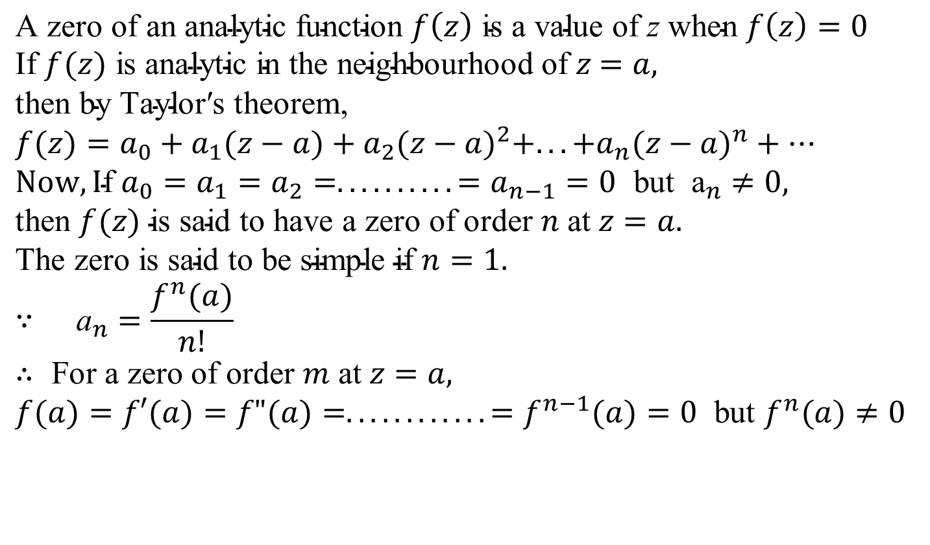
Zero of an Analytic Function(CO2)
$$\text{A} \text{zero} \text{of} \text{an} \text{analytic} \text{function} f\left(z\right) \text{is} \text{a} \text{value} \text{of} \text{z} \text{when} f\left(z\right)=0$$ $\text{If} f(z) \text{is} \text{analytic} \text{in} \text{the} \text{neighbourhood} \text{of} z$ $=a,$
$\text{then} \text{by} \text{Taylor}\text{′}\text{s} \text{theorem}$, $$f(z)=a_{0}+a_{1}(z−a)+a_{2}(z−a)^{2}+...+a_{n}(z−a)^{n}+… \\ Now, \text{I}\text{f} a_{0}=a_{1}=a_{2}=..........=a_{n−1}=0 \text{but} {\text{a}}_{n}≠0, \\ \text{then} f(z) \text{is} \text{said} \text{to} \text{have} \text{a} \text{zero} \text{of} \text{order} n \text{at} z=a. \\ \text{The} \text{zero} \text{is} \text{said} \text{to} \text{be} \text{simple} \text{if} n=1. \\ ∵ {\text{a}}_{n}=\frac{f^{n}(a)}{n!} \\ ∴ \text{F}\text{or} \text{a} \text{zero} \text{of} \text{order} m \text{at} z=a, \\ f(a)=f′(a)=f"(a)=............=f^{n−1}(a)=0 \text{but} f^{n}(a)≠0$$

Slide 57
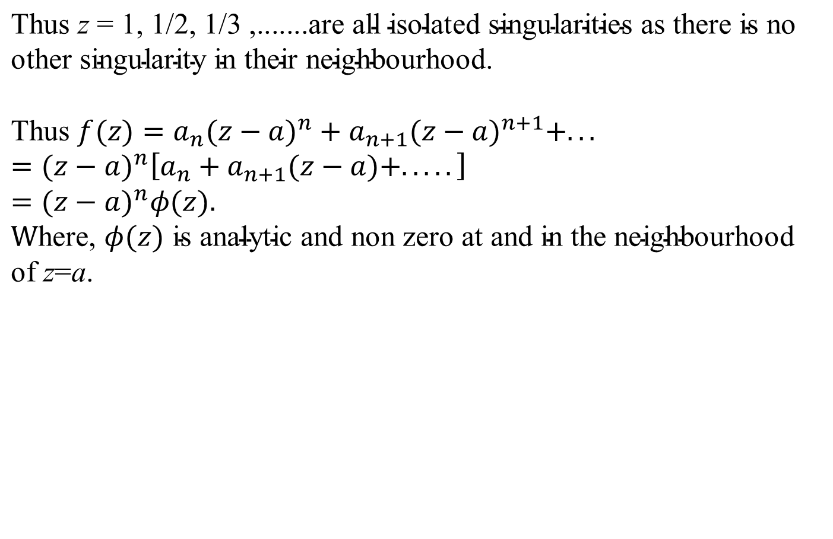
Zero of an Analytic Function(CO2)
$$\text{Thus} \text{z} \text{=} \text{1, 1/2, 1/3 ,.......}\text{are} \text{all} \text{isolated} \text{singularities} \text{as} \text{there} \text{is} \text{no} \\ \text{other} \text{singularity} \text{in} \text{their} \text{neighbourhood}\text{.}$$
$$\text{Thus} f(z)=a_{n}(z−a)^{n}+a_{n+1}(z−a)^{n+1}+...=(z−a)^{n}\left[a_{n}+a_{n+1}(z−a)+.....\right] \\ =(z−a)^{n}φ(z)\text{.}$$
$$\text{W}\text{here}\text{,} φ(z) \text{is} \text{analytic} \text{and} \text{non} \text{zero} \text{at} \text{and} \text{in} \text{the} \text{neighbourhood} \text{of} \text{z}\text{=}\text{a}\text{.}$$

Slide 58
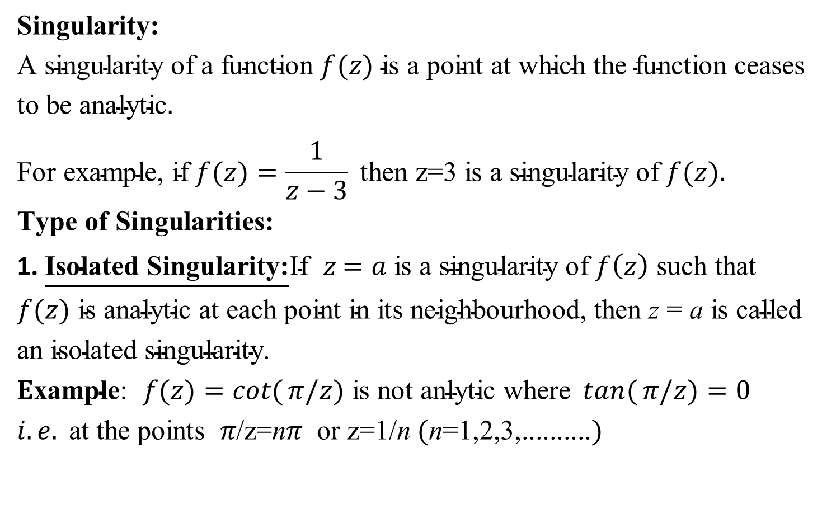
Singularity(CO2)
$$\text{Singularity}\text{:} \\ \text{A} \text{singularity} \text{of} \text{a} \text{function} f(z) \text{is} \text{a} \text{point} \text{at} \text{which} \text{the} \text{function} \text{ceases} \text{to} \text{be} \text{analytic}.$$
$$\text{Fo}\text{r} \text{example}\text{,} \text{if} f(z)=\frac{1}{z−3} \text{then} \text{z}\text{=3 }\text{is} \text{a} \text{singularity} \text{of} f(z).$$
$$\text{Type} \text{of} \text{Singularities}\text{:}$$
1. $\underline{\text{Isolated} \text{Singularity}\text{:}}\text{If} z$ $=a \text{is} \text{a} \text{singularity} \text{of} f\left(z\right) \text{such} \text{that}$
$$f(z) \text{is} \text{analytic} \text{at} \text{each} \text{point} \text{in} \text{its} \text{neighbourhood}\text{, }\text{then} \text{z}\text{ = }\text{a} \text{is} \text{called} \text{an} \text{isolated} \text{singularity}\text{.}$$
$$E\text{xample}\text{:} f(z)=\cot{(}π/z) \text{is} \text{not} \text{anlytic} \text{where} \tan{(}π/z)=0 \\ i.e. \text{at} \text{the} \text{points} π\text{/}\text{z}\text{=}\text{n}π \text{or} \text{z}\text{=1/}\text{n} (\text{n}\text{=1,2,3,..........})$$

Slide 59
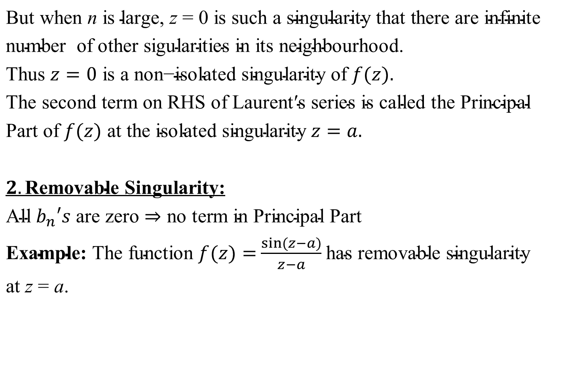
Singularity(CO2)
$$\text{But} \text{when} \text{n} \text{is} \text{large}\text{, }\text{z} \text{=} \text{0 }\text{is} \text{such} \text{a} \text{singularity} \text{that} \text{there} \text{are} \text{infinite} \text{number} \text{of} \text{other} \text{sigularities} \text{in} \text{its} \text{neighbourhood}\text{.}$$
$$\text{Thus} z=0 \text{is} \text{a} \text{non}\text{−}\text{isolated} \text{singularity} \text{of} f(z). \\ \text{The} \text{second} \text{term} \text{on} \text{RHS} \text{of} \text{Laurent}\text{′}\text{s} \text{series} \text{is} \text{called} \text{the} \text{Principal} \text{Part} \text{of} f(z) \text{at} \text{the} \text{isolated} \text{singularity} z=a.$$
$$2.\text{Removable} \text{Singularity}\text{:} \\ \text{All} b_{n}′s \text{are} \text{zero}⇒\text{no} \text{term} \text{in} \text{Principal} \text{Part}$$ $\text{Example}\text{:} \text{The} \text{function} f(z)=$ $\frac{\sin{(}z−a)}{z−a}$ $\text{has} \text{removable} \text{singularity}$
$$\text{at} \text{z} \text{=} \text{a}\text{.}$$

Slide 60

Singularity(CO2)
$$3.\text{Essential} \text{Singularity}\text{:} \\ \text{Infinite} \text{number} \text{of} \text{terms} \text{in} \text{Principal} \text{Part} \\ \text{Example}\text{:}$$
$$\text{The} \text{function} f(z=\sin{\frac{1}{z−a}} \text{has} \text{essential} \text{singularity} \text{at} \text{z}\text{ = }\text{a}\text{.}$$

Slide 61
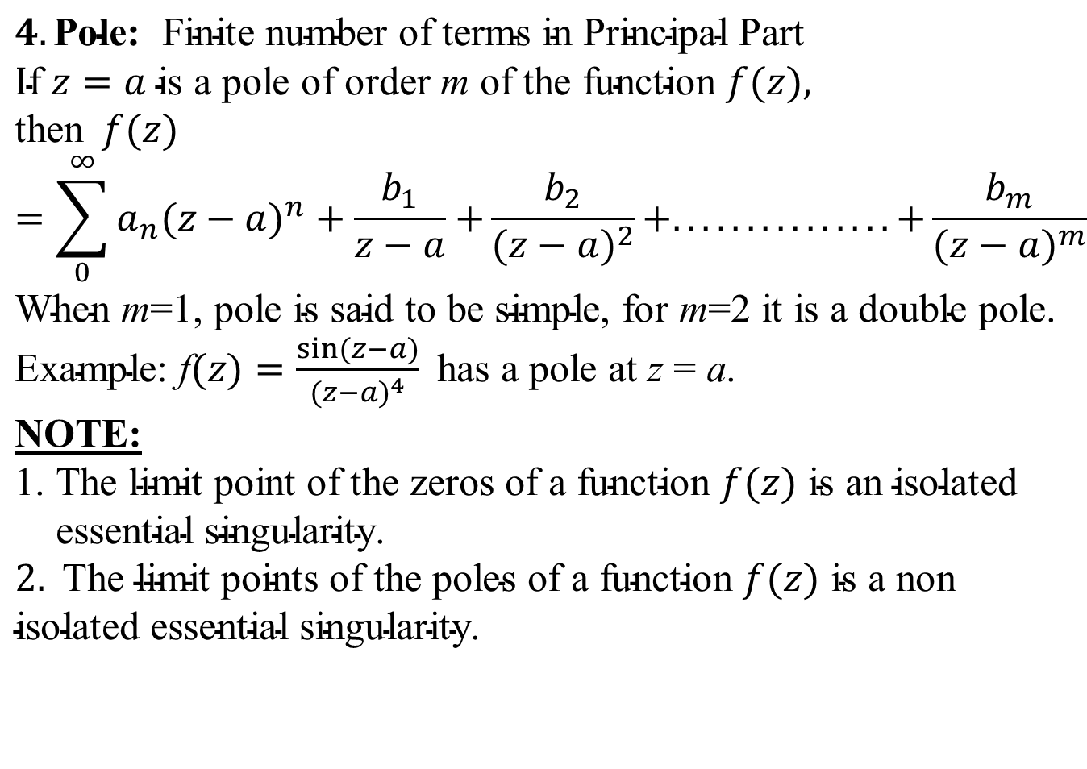
Singularity(CO2)
$$4.\text{Pole}\text{:} \text{Finite} \text{number} \text{of} \text{terms} \text{in} \text{Principal} \text{Part}$$
$$\text{I}\text{f} z=a \text{is} \text{a} \text{pole} \text{of} \text{order} \text{m} \text{of} \text{the} \text{function} f(z), \\ \text{then} f(z)=\sum_{0}^{∞}{a_{n}(z−a)^{n}+\frac{b_{1}}{z−a}+}\frac{b_{2}}{(z−a)^{2}}+...............+\frac{b_{m}}{(z−a)^{m}} \\ \text{When} \text{m}\text{=1, }\text{pole} \text{is} \text{said} \text{to} \text{be} \text{simple}\text{,} \text{for} \text{m}\text{=2 }\text{it} \text{is} \text{a} \text{double} \text{pole}\text{.}$$ $\text{Example}\text{: }\text{f}(z)=\frac{\sin{(}z−a)}{(z−a)^{4}} \text{has} \text{a} \text{pole} \text{at} \text{z} \text{=} \text{a}$.
$$\text{NOTE}\text{:} \\ \text{1. }\text{The} \text{limit} \text{point} \text{of} \text{the} \text{zeros} \text{of} \text{a} \text{function} f(z) \text{is} \text{an} \text{isolated} \\ \text{essential} \text{singularity}\text{.} \\ 2. \text{The} \text{limit} \text{points} \text{of} \text{the} \text{poles} \text{of} \text{a} \text{function} f(z) \text{is} \text{a} \text{no}\text{n} \text{isolated} \text{essential} \text{singularity}\text{.}$$

Slide 62

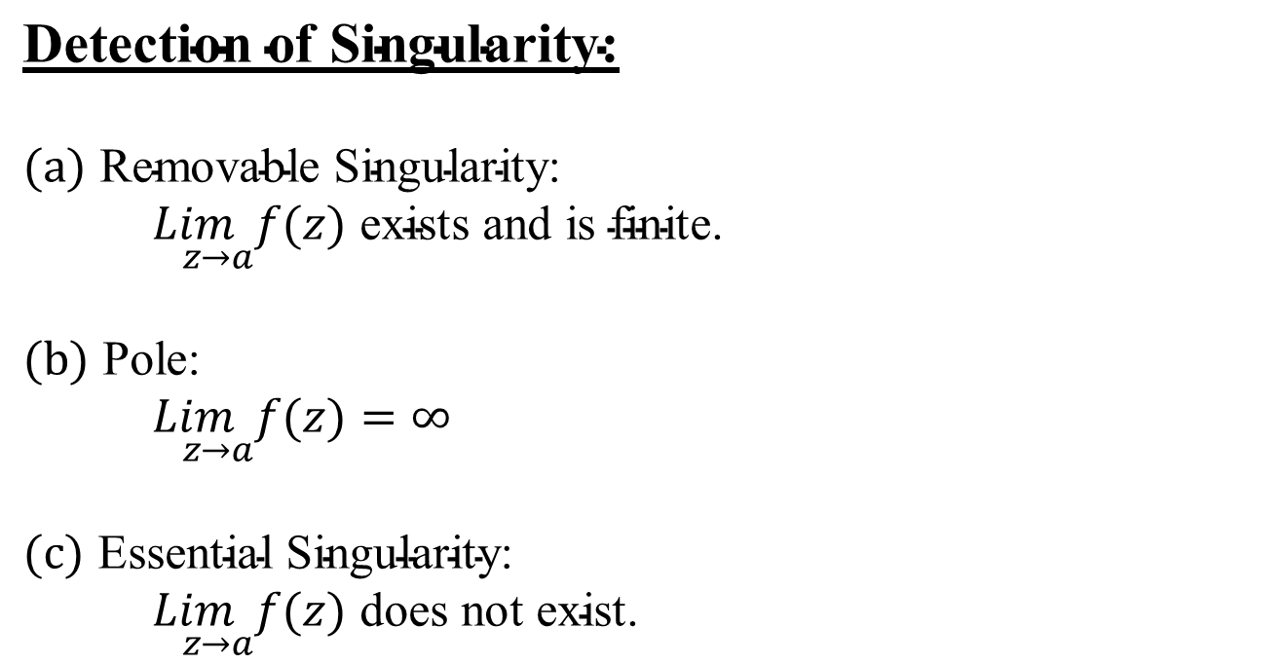
Singularity(CO2)
$$\text{Detection}​ \text{o}\text{f} \text{Singularity}\text{:}$$
$$(a) \text{Removable} \text{Singularity}\text{:} \\ \underset{ z→a}{Lim}f(z) \text{exists} \text{and} \text{is} \text{finite}\text{.}$$
$$(b) \text{Pole}\text{:} \\ \underset{ z→a}{Lim}f(z)=∞$$
$$(c) \text{Essential} \text{Singularity}\text{:} \\ \underset{ z→a}{Lim}f(z) \text{does} \text{not} \text{exist}\text{. }$$

Slide 63

Daily Quiz(CO2)
$$\left(a\right) f(z)=\frac{z−\sin{z}}{z^{3}} \text{at} z=0. \\ \left(b\right) f\left(z\right)=\frac{1}{1−e^{z}} \text{at} z=2πi. \\ (c) f(z)=\frac{e^{1/z}}{z^{2}} \text{at} z=0.$$

Slide 64

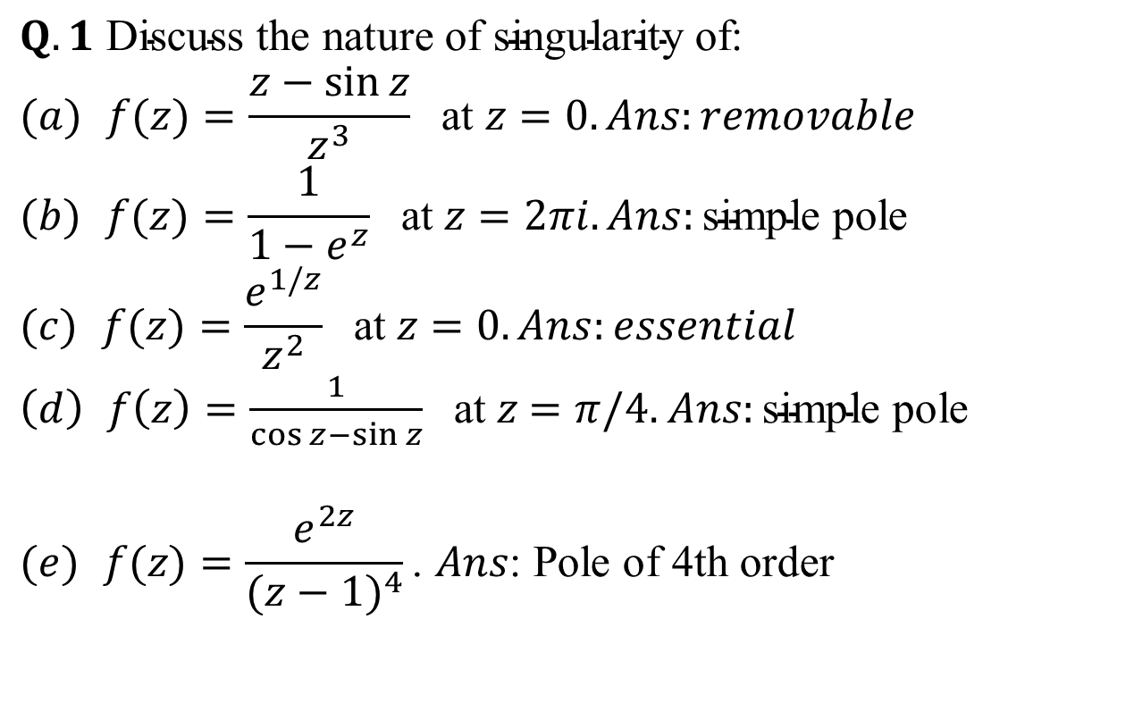
Weekly Assignment(CO2)
$$Q.1 \text{Discuss} \text{the} \text{nature} \text{of} \text{singularity} \text{of}\text{:} \\ (a) f(z)=\frac{z−\sin{z}}{z^{3}} \text{at} z=0.Ans:removable \\ (b) f(z)=\frac{1}{1−e^{z}} \text{at} z=2πi.Ans:\text{simple} \text{pole} \\ (c) f(z)=\frac{e^{1/z}}{z^{2}} \text{at} z=0.Ans:essential$$ $\left(d\right) f\left(z\right)=\frac{1}{\cos{z}−\sin{z}} \text{at} z$ $=π/4.$ $Ans:\text{simple} \text{pole}$
$$(e) f(z)=\frac{e^{2z}}{(z−1)^{4}}\text{.} Ans\text{: }\text{Pole} \text{of}\text{ 4}\text{th} \text{order}$$

Slide 65

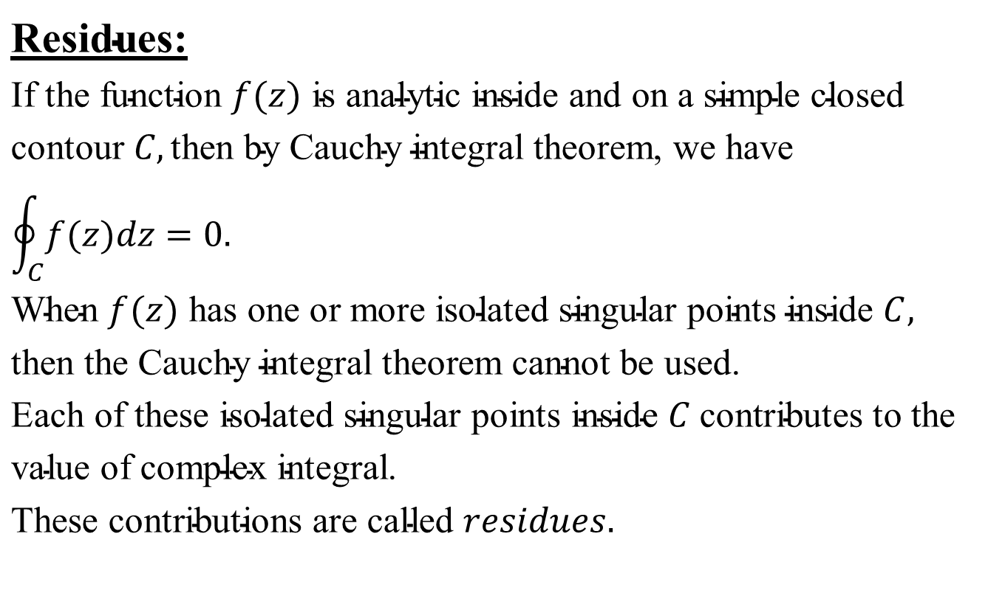
Residue(CO2)
$$\text{Residues}\text{:} \\ \text{If} \text{the} \text{function} f(z) \text{is} \text{analytic} \text{inside} \text{and} \text{on} \text{a} \text{simple} \text{closed} \text{contour} C,\text{then} \text{by} \text{Cauchy} \text{integral} \text{theorem}\text{, }\text{we} \text{have}$$
$$\oint_{C}{f(z)dz=0.} \\ \text{When} f(z) \text{has} \text{one} \text{or} \text{more} \text{isolated} \text{singular} \text{points} \text{inside} C, \\ \text{then} \text{the} \text{Cauchy} \text{integral} \text{theorem} \text{cannot} \text{be} \text{used}\text{.} \\ \text{Each} \text{of} \text{these} \text{isolated} \text{singular} \text{points} \text{inside} C \text{contributes} \text{to} \text{the} \text{value} \text{of} \text{complex} \text{integral}\text{.} \\ \text{These} \text{contributions} \text{are} \text{called} residues.$$

Slide 66
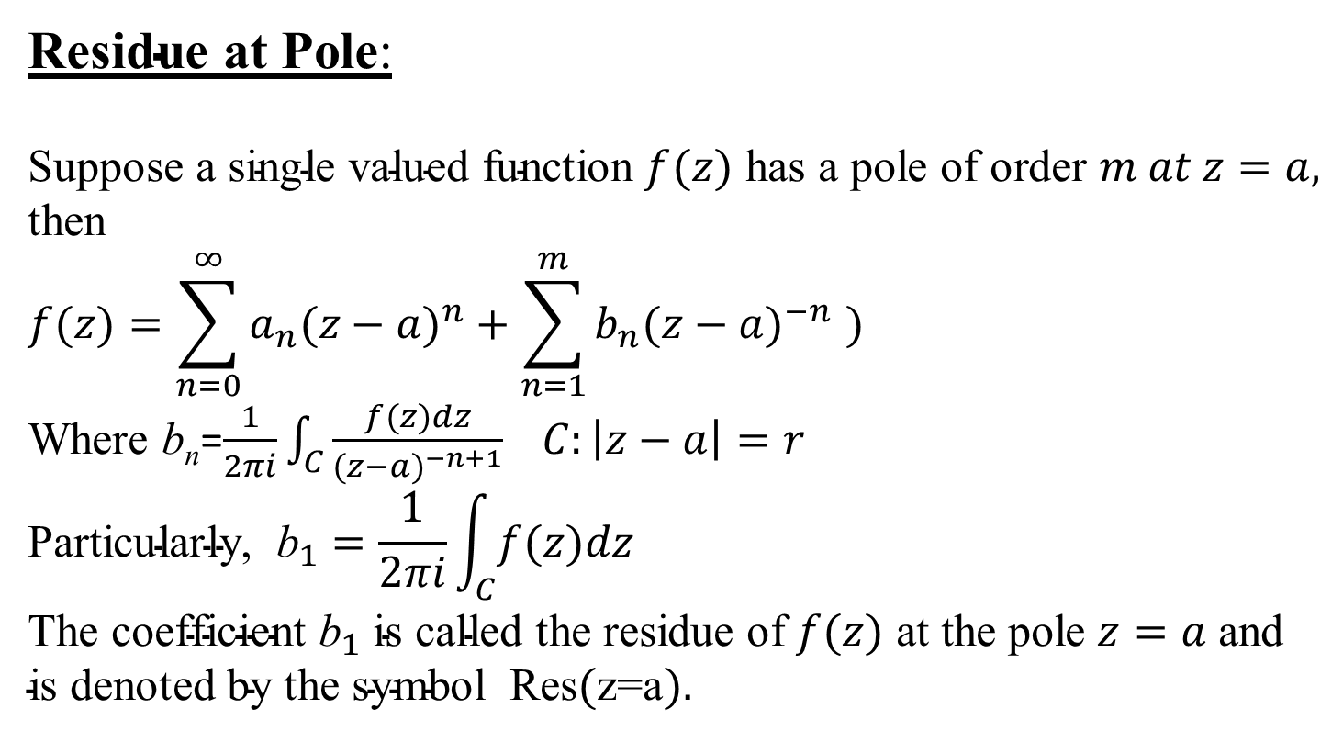
Residue(CO2)
$\text{Residue} \text{at} \text{Pole}$:
$$\text{Suppose} \text{a} \text{single} \text{valued} \text{function} f(z) \text{has} \text{a} \text{pole} \text{of} \text{order} m at z=a, \\ \text{then}$$
$$f(z)=\sum_{n=0}^{∞}{a_{n}(z−a)^{n}+\sum_{n=1}^{m}{b_{n}(z−a)^{−n} }})$$
Where b_{n}=$\frac{1}{2πi}\int_{C}{\frac{f(z)dz}{(z−a)^{−n+1}}} C:\left|z−a\right|=r$ $$\text{Particularly}\text{, }{\text{b}}_{1}=\frac{1}{2πi}\int_{C}{f(z)dz} \\ \text{The} \text{coefficient} {\text{b}}_{1} \text{is} \text{called} \text{the} \text{residue} \text{of} f(z) \text{at} \text{the} \text{pole} z=a \text{and} \\ \text{is} \text{denoted} \text{by} \text{the} \text{symbol} \text{Res}(\text{z}\text{=}\text{a}).$$

Slide 67

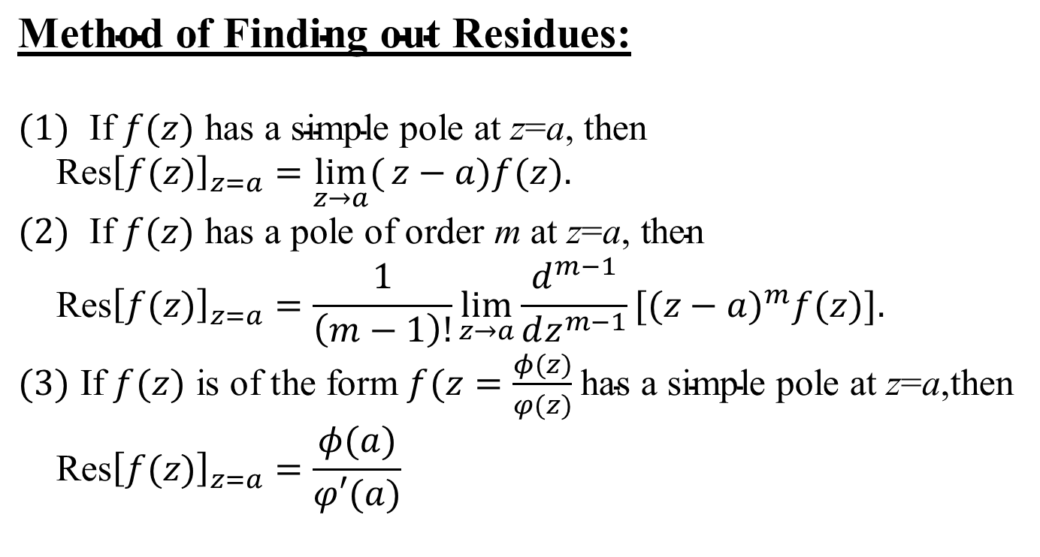
Residue(CO2)
$$\text{Method} \text{of} \text{Finding} \text{out} \text{Residues}\text{:}$$
$$(1) \text{If} f(z) \text{has} \text{a} \text{simple} \text{pole} \text{at} \text{z}\text{=}\text{a}\text{, }\text{then} \\ \text{Res}{\left[f(z)\right]}_{z=a}=\lim_{z→a}{(}z−a)f(z). \\ (2) \text{If} f(z) \text{has} \text{a} \text{pole} \text{of} \text{order} \text{m} \text{at} \text{z}\text{=}\text{a}\text{, }\text{then} \\ \text{Res}{\left[f(z)\right]}_{z=a}=\frac{1}{\left(m−1\right)!}\lim_{z→a}{\frac{d^{m−1}}{dz^{m−1}}}[(z−a)^{m}f(z)].$$ $(3) \text{If} f(z) \text{is} \text{of} \text{the} \text{form} f(z=\frac{φ(z)}{φ(z)}$ $\text{has} \text{a} \text{simple} \text{pole} \text{at} \text{z}\text{=}\text{a}\text{,}\text{then}$ $$\text{Res}{\left[f(z)\right]}_{z=a}=\frac{φ(a)}{φ′(a)}$$

Slide 68
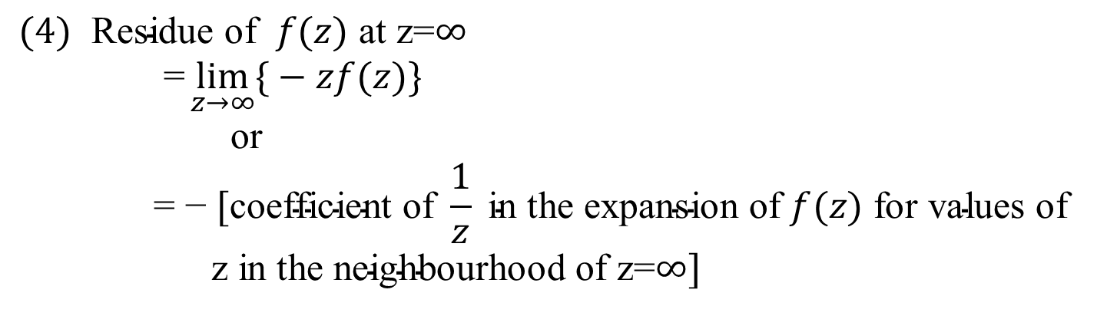
Residue(CO2)
$$(4) \text{Residue} \text{of} f(z) \text{at} \text{z}\text{=}∞ \\ \text{ =}\lim_{z→∞}{\{}−zf(z)\} \\ \text{or} \\ \text{ = − }[\text{coefficient} \text{of} \frac{1}{z} \text{in} \text{the} \text{expansion} \text{of} f(z) \text{for} \text{values} \text{of} \text{z} \text{in} \text{the} \text{neighbourhood} \text{of} \text{z}\text{=}∞]$$

Slide 69
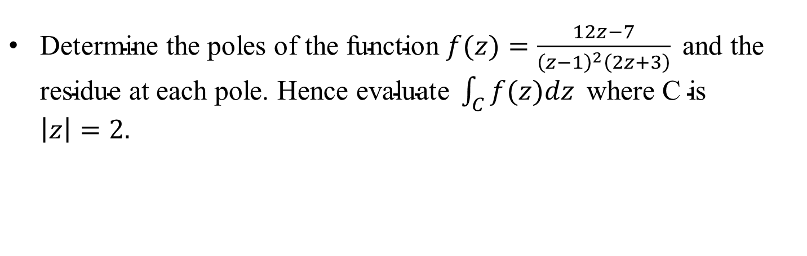
Daily Quiz(CO2)
$\text{Determine} \text{the} \text{poles} \text{of} \text{the} \text{function} f(z)=\frac{12z−7}{{\left(z−1\right)}^{2}\left(2z+3\right)} \text{and} \text{the} \text{residue} \text{at} \text{each} \text{pole}\text{. }\text{Hence} \text{evaluate} \int_{C}{f(z)dz} \text{where} \text{C} \text{is} \left|z\right|=2.$

Slide 70

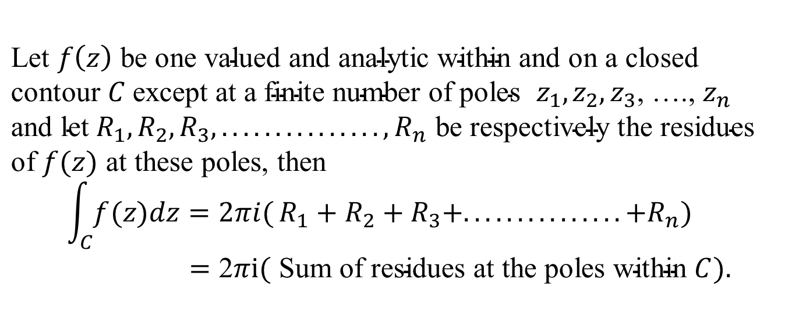
Cauchy’s Residue Theorem(CO2)
$\text{Let} f\left(z\right) \text{be} \text{one} \text{valued} \text{and} \text{analytic} \text{within} \text{and} \text{on} \text{a} \text{closed} \text{contour} C \text{except} \text{at} \text{a} \text{finite} \text{number} \text{of}$ $\text{poles} z_{1},z_{2},z_{3}$, …., $z_{n}$
$$\text{and} \text{let} {R_{1},R_{2},R_{3},...............,R}_{n} \text{be} \text{respectively} \text{the} \text{residues} \\ \text{of} f(z) \text{at} \text{these} \text{poles}\text{, }\text{then} \\ \int_{C}{f(z)dz=2πi(}R_{1}+R_{2}+R_{3}+...............+R_{n})$$ $=\text{2}πi( \text{Sum} \text{of} \text{residues} \text{at} \text{the} \text{poles} \text{within} C).$

Slide 71
Recap(CO2)
We have discussed.
Zero and singularity
Residue
Cauchy’s Residue theorem

Slide 72

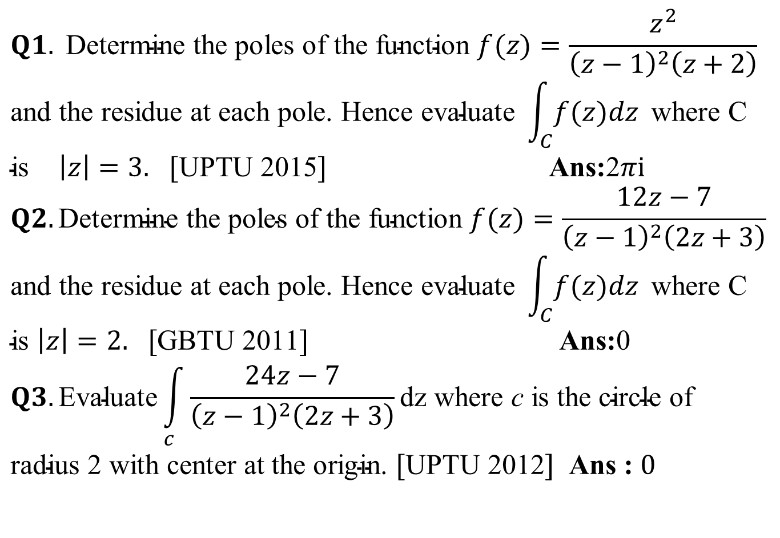
Weekly Assignment(CO2)
$$Q1. \text{Determine} \text{the} \text{poles} \text{of} \text{the} \text{function} f(z)=\frac{z^{2}}{{\left(z−1\right)}^{2}\left(z+2\right)}$$
$$\text{and} \text{the} \text{residue} \text{at} \text{each} \text{pole}\text{. }\text{Hence} \text{evaluate} \int_{C}{f(z)dz} \text{where} \text{C} \text{is} \left|z\right|=3. [\text{UPTU}\text{ 2015}] \text{Ans}\text{:}\text{2}πi \\ Q2.\text{Determine} \text{the} \text{poles} \text{of} \text{the} \text{function} f(z)=\frac{12z−7}{{\left(z−1\right)}^{2}\left(2z+3\right)}$$
$$\text{and} \text{the} \text{residue} \text{at} \text{each} \text{pole}\text{. }\text{Hence} \text{evaluate} \int_{C}{f(z)dz} \text{where} \text{C} \text{is} \left|z\right|=2. [\text{GBTU}\text{ 2011}] \text{Ans}\text{:}\text{0}$$
$$Q3.\text{Evaluate}\int_{c}{\frac{24z−7}{{\left(z−1\right)}^{2}\left(2z+3\right)}}\text{dz} \text{where} \text{c} \text{is} \text{the} \text{circle} \text{of} \text{radius}\text{ 2 }\text{with} \text{center} \text{at} \text{the} \text{origin}\text{. }[\text{UPTU}\text{ 2012}] \text{Ans}\text{ : }0$$

Slide 73
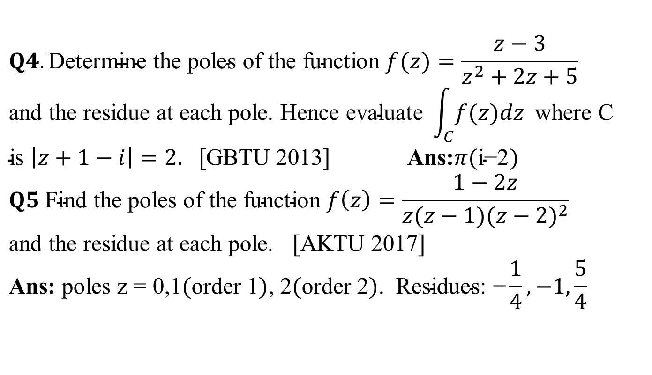
Weekly Assignment(CO2)
$$Q4.\text{Determine} \text{the} \text{poles} \text{of} \text{the} \text{function} f(z)=\frac{z−3}{z^{2}+2z+5}$$
$$\text{and} \text{the} \text{residue} \text{at} \text{each} \text{pole}\text{. }\text{Hence} \text{evaluate} \int_{C}{f(z)dz} \text{where} \text{C} \text{is} \left|z+1−i\right|=2. [\text{GBTU}\text{ 2013}] \text{Ans}\text{:}π(\text{i}\text{−2}) \\ Q5 \text{Find} \text{the} \text{poles} \text{of} \text{the} \text{function} f\left(z\right)=\frac{1−2z}{z(z−1)(z−2)^{2}}$$
$$\text{and} \text{the} \text{residue} \text{at} \text{each} \text{pole}\text{. }[\text{AKTU}\text{ 2017}] \\ \text{Ans}\text{:} \text{poles} \text{z}\text{ = 0,1}(\text{order}\text{ 1})\text{, 2}(\text{order}\text{ 2})\text{. }\text{Residues}\text{: −}\frac{1}{4},−1,\frac{5}{4}$$

Slide 74
Topic Objective(CO2)
We are going to discuss:
Evaluation of real integrals using residue theorem.

Slide 75

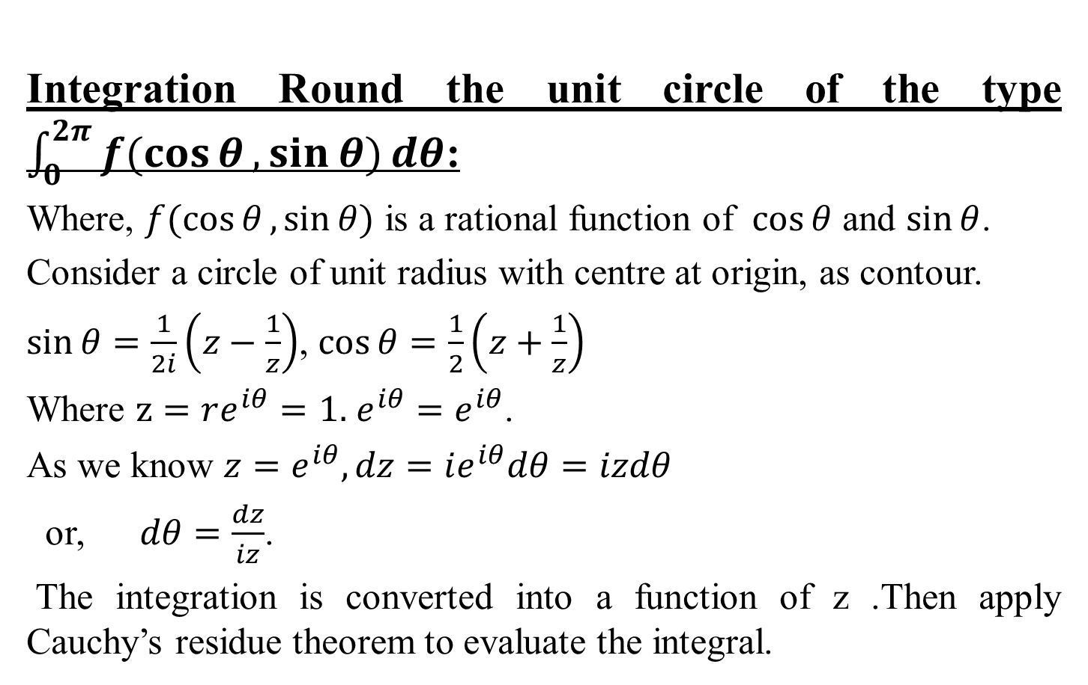
Evaluation of Real Integral(CO2)
Integration Round the unit circle of the type $\int_{0}^{2π}{f(\cos{θ},\sin{θ)}dθ}$:
Where, $f(\cos{θ},\sin{θ)}$ is a rational function of $\cos{θ}$ and $\sin{θ}$.
Consider a circle of unit radius with centre at origin, as contour.
$\sin{θ}=\frac{1}{2i}\left(z−\frac{1}{z}\right)$, $\cos{θ}=\frac{1}{2}\left(z+\frac{1}{z}\right)$
Where $z=re^{iθ}=1.$ $e^{iθ}=e^{iθ}$.
As we know $z=e^{iθ}, dz=ie^{iθ}dθ=izdθ$
or, $dθ=\frac{dz}{iz}$.
The integration is converted into a function of z .Then apply Cauchy’s residue theorem to evaluate the integral.

Slide 76

Weekly Assignment(CO2)
Q.1.Evaluate the integral $\int_{0}^{2π}{\frac{dθ}{5−3\cos{θ}}}$ .
Q.2.Evaluate the integral $\int_{0}^{2π}{\frac{dθ}{a+b\sin{θ}}}$ if $a>\left|b\right|$.
Q.3.Using contour integration, Evaluate $\int_{0}^{2π}{\frac{dθ}{a+b\cos{θ}}}$
Where $a>\left|b\right|$ hence or otherwise Evaluate $\int_{0}^{π}{\frac{dθ}{a+b\cos{θ}}}$

Slide 77

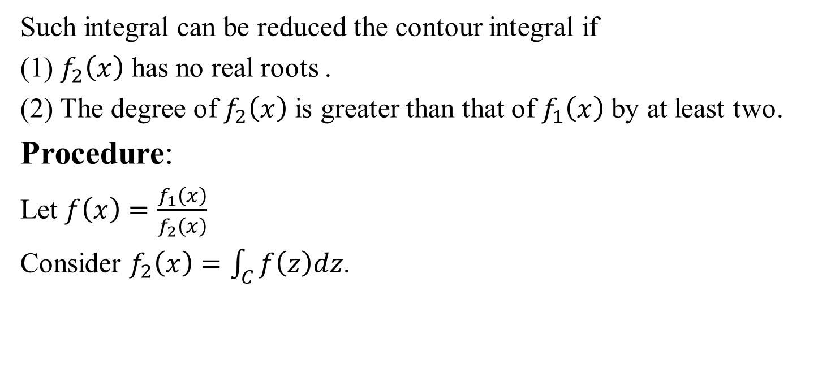
Evaluation of Real Integrals (CO2)
Such integral can be reduced the contour integral if
(1) $f_{2}\left(x\right)$ has no real roots .
(2) The degree of $f_{2}\left(x\right)$ is greater than that of $f_{1}\left(x\right)$ by at least two.
Procedure:
Let $f\left(x\right)=\frac{f_{1}\left(x\right)}{f_{2}\left(x\right)}$
Consider $f_{2}\left(x\right)=\int_{C}^{ }{f\left(z\right)dz}$.

Slide 78


Evaluation of Real Integrals (CO2)
Where C is a curve , consisting of the upper half $C_{R}$ of the circle $\left|z\right|=R$ and part of the real axis from –R to R.
If there are no poles of $f(z)$ on the real axis , the circle $\left|z\right|=R$ which is arbitrary can be taken such that there is no singularity on its circumference $C_{R}$ in the upper half of the plane, but possibly some poles inside the contour C specified
above.
Using Cauchy’s Residue theorem, we have
$\int_{C}^{ }{f\left(z\right)dz=2πi }$(sum of residue of $f(z)$ at the poles within C)
i.e. $\int_{−R}^{R}{f\left(x\right)dx+\int_{C_{R}}^{ }{f\left(z\right)dz}}$ $=2πi$(sum of residue of $f(z)$ at the poles within C)

Slide 79


Evaluation of Real Integrals (CO2)
or, $\int_{−R}^{R}{f\left(x\right)dx}$ $=−\int_{C_{R}}^{ }{f\left(z\right)dz}+2πi$ (sum of residue of $f(z)$ at the poles within C)
$∴ \lim_{R→∞}{\int_{−R}^{R}{f\left(x\right)dx}}$ $=−\lim_{R→∞}\int_{C_{R}}^{ }{f\left(z\right)dz}+2πi$
(sum of residue of $f(z)$ at the poles within C) …………(1)
Now, $\lim_{R→∞}\int_{C_{R}}^{ }{f\left(z\right)dz}=\int_{0}^{π}{f(Re^{iθ})}Rie^{iθ}dθ=0$
$∴\int_{−∞}^{∞}{f\left(x\right)dx=2πi}$ (sum of residue within C)

Slide 80
Recap(CO2)
We have discussed.
Evaluation of real integrals using residue theorem.

Slide 81

Weekly Assignment(CO2)
Q.1. Apply calculus of residues to prove that
$\int_{0}^{∞}{\frac{dx}{{\left(x^{2}+a^{2}\right)}^{2}}=\frac{π}{4a^{3}}};a>0$
Q.2. Evaluate $\int_{0}^{∞}{\frac{\cos{mx}}{\left(x^{2}+1\right)}dx}$
Q.3. Evaluate $\int_{0}^{∞}{\frac{\sin{x}}{x}dx}$
Q.4. Evaluate $\int_{−∞}^{∞}{\frac{x\sin{πx}}{\left(x^{2}+2x+5\right)}dx}$
Q.5. Evaluate $\int_{−∞}^{∞}{\frac{x^{2}−x+2}{\left(x^{4}+10x^{2}+9\right)}dx}$

Slide 82
Video Links (CO2)
Video Links:
https://www.youtube.com/playlist?list=PLzJaFd3A7DZuyLLbmVpb9e9V3Q9cYBL
https://www.youtube.com/playlist?list=PLbMVogVj5nJS_i8vfVWJG16mPcoEKMuWT
https://youtu.be/b5VUnapu-qs
https://youtu.be/b5VUnapu-qs
https://youtu.be/yV_v6zxADgY
https://youtu.be/2ZBcbFhrfOg
https://youtu.be/dlK0E0OG39k
https://youtu.be/qjpLIlVo_6E

Slide 83






MCQ(CO2)
Q1. along the path y = x is equal to
(a) (b) (c) (d)
Ans. (a)
$\text{Q}2.$If there is no pole inside and on the contour, then the value of integral is
(a) ∞ (b) 0 (c) –1 (d) 1
Ans. (b)
$$\int_{0}^{2+i}{(x^{2}+iy)dz}$$
$$\left(\frac{2}{3}+\frac{14}{3}i\right)$$
$$\left(\frac{3}{2}+\frac{3}{14}i\right)$$
$$\left(\frac{2}{3}−\frac{14}{3}i\right)$$
$$\left(\frac{3}{2}−\frac{4}{14}i\right)$$

Slide 84
Glossary Question(CO2)
Q1. Pick the correct option from the glossary:
(i) cos z
(ii) sin z
(iii) log (1+z)
(iv) tan z
A. z - z²/2+z³/3-… .
B. 1 - z²/2! + z⁴/4!-… .
C. z - z³/3! + z⁵/5!-… .
D. z + z³/3+2 z⁵/15+… .

Slide 85
First Sessional Paper

Slide 86

First Sessional Paper

Slide 87
First Sessional Paper

Slide 88

First Sessional Paper

Slide 89

First Sessional Paper

Slide 90
Second Sessional Paper

Slide 91
Second Sessional Paper

Slide 92
Second Sessional Paper

Slide 93
Second Sessional Paper

Slide 94
Third Sessional Paper

Slide 95
Third Sessional Paper

Slide 96
Third Sessional Paper

Slide 97
Third Sessional Paper

Slide 98

Expected Questions (CO2)
Q1. If $f(z)$is a regular function of z, prove that
$\left(\frac{∂^{2}}{∂x^{2}}+\frac{∂^{2}}{∂y^{2}}\right){\left|f(z)\right|}^{2}={4\left|f^{′}(z)\right|}^{2}$.
Q2. If $u−v=\left(x−y\right)\left(x^{2}+4xy+y^{2}\right)$ and $f(z)$ is an analytic function . Find $f(z)$ in terms of $z$.
Q3. Find the bilinear transformation which maps the points$z=0,1,∞$ into the points $w= i,−1,−i$ respectively.
Q4. Consider the transformation $z=\sqrt{2}e^{\frac{iπ}{4}} z$ and determine the region $R’$ of $w$ –plane corresponding to rectangular region $R$ bounded by the lines $x=0, y=0 , x=2$ and $y=1$ in $z$-plane.

Slide 99

Expected Questions(CO2)
Q5. Expand $\frac{1}{(z+1)(z+3)} i$n the region$\left|z\right|<1.$
Q6. Use Cauchy integral formula to evaluate$\oint_{c}^{ }{\frac{sinπz2+cosπz2}{(z−1)(z−2)}}dz$ where C is the circle $\left|z\right|=3$ .
Q7. Evaluate $\int_{C}{\frac{e^{2z}}{\left(z^{2}−3z+2\right)} dz }$ where C is the circle $\left|z\right|=3$ .
Q8. Evaluate $\int_{0}^{∞}{\frac{\cos{mx}}{\left(x^{2}+1\right)}dx}$.
Q9. Evaluate $\int_{0}^{∞}{\frac{\sin{x}}{x}dx}.$

Slide 100
Recapof Unit(CO2)
We discussed following points in this unit.
Limit, Continuity and differentiability
Functions of complex variable,
Analytic functions
Cauchy- Riemann equations (Cartesian and Polar form),
Harmonic function
Method to find Analytic functions
Conformal mapping
Mobius transformation and their properties.

Slide 101
References
Erwin Kreyszig, Advanced Engineering Mathematics, 9th Edition, John Wiley & Sons, 2006.
P. G. Hoel, S. C. Port and C. J. Stone, Introduction to Probability Theory, Universal Book Stall, 2003(Reprint).
S. Ross: A First Course in Probability, 6th Ed., Pearson Education India, 2002.
W. Feller, An Introduction to Probability Theory and its Applications, Vol. 1, 3rd Ed., Wiley, 1968.

Slide 102
References
R.K. Jain and S.R.K. Iyenger: Advance Engineering Mathematics; Narosa Publishing House, New Delhi.
B.S. Grewal, Higher Engineering Mathematics, Khanna Publishers, 35th Edition, 2000. 2.T.Veerarajan : Engineering Mathematics (for semester III), Tata McGraw-Hill, New Delhi.
J.N. Kapur: Mathematical Statistics; S. Chand & Sons Company Limited, New Delhi.
D.N.Elhance,V. Elhance & B.M. Aggarwal: Fundamentals of Statistics; Kitab Mahal Distributers, New Delhi.

Slide 103

Thank You

